Slide 1
VOLUNTOURISM
SOCIAL PERSPECTIVES
Y7&8
11-13 years

Slide 2
L O O K I N G B E Y O N D
T H E S E L F I E S
W E E K 2
15 M I N U T E S

Slide 3
In this lesson, students will:
THINK!
Think about and discuss some of the benefits and ripple effects that come when volunteering overseas.
Understand how our choices affect many people who we will never see, and understand the need for being conscious of the wider ripple effects of our own actions
Explore and unravel some of the consequences of Voluntourism upon communities and re-think new approaches
FEEL!
CONNECT!

Slide 4
P R E L E S S O N
R E F L E C T I O N S
3 – 5 M I N U T E S +

Slide 5
Introduce the following REFLECTIVE QUESTIONS for students to consider during the lesson:
What is the attraction of volunteering overseas?
What are some of the common volunteering opportunities that exist for young people in overseas projects?
Why do you often not require any skills in these industries when volunteering overseas?
Why might we take a different attitude to volunteering when it is in another country?

Slide 6
I N T R O D U C I N G T H E V O L U N T O U R I S T
1 5 M I N U T E S +

Slide 7
The world of Voluntourism
How much do you really know?

Slide 8
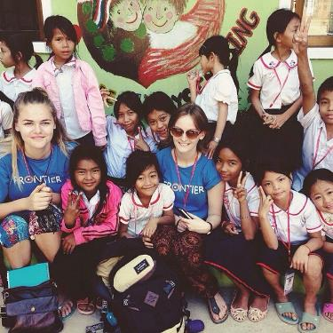
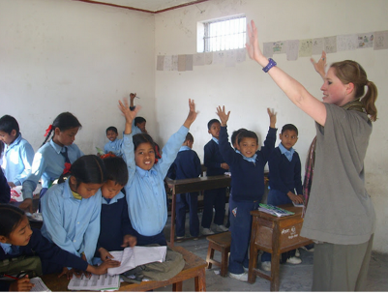
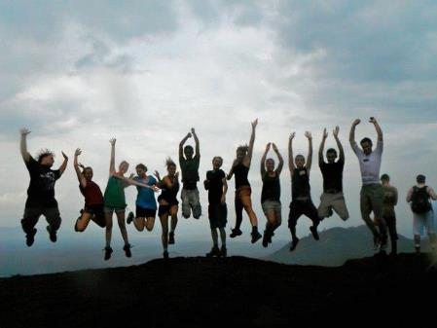
What is Voluntourism?
Ask the class to give their responses…
Notes:
One way that young people can be encouraged to be involved with the wider world, is through volunteering tourism...

Slide 9
Voluntourism is…
“…traveling to a place to improve the economic well-being, socio-cultural development, or environmental conservation by providing volunteer assistance and/or goods and services.”
More simply put, Voluntourism is a form of tourism in which travellers participate in voluntary work (typically for a charity) during their travels.

Slide 10
Who is doing it?
There are several million people volunteering internationally each year, with numbers growing rapidly over the past few years. Africa is the most popular continent for people to go to volunteer, closely followed by South Asia, whilst India and the Philippines are currently the most popular countries.
There are over 2000 registered volunteer organisations across the world offering a range of packages to suit your wishes. Voluntourism is now a billion dollar industry.
You may have heard of some of the following organisations:

Slide 12
There are many positive ripple effects that come from Voluntourism; many of which have been mentioned already and most of which you probably already know (or can think of).
However…
there are also many negative ripple effects happening across the world from this booming industry; many of which are only just starting to be talked about...

Slide 13
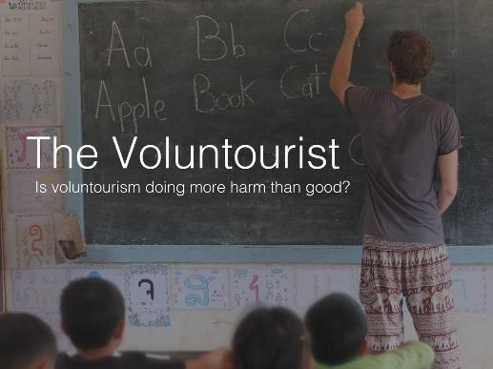
Watch some or all of a short extract (7.26 mins) taken from the full length documentary The Voluntourist made by Chloe Sanguinetti entitled:
The Volunteer’s Journey
Click on the link above for the film)

Slide 14
Allow students a few moments to respond to the film with the people sitting next to them.
Then as a group discuss initial responses and ideas related to the following questions:

Slide 15
Was there anything surprising in the film? What and why?

Slide 16
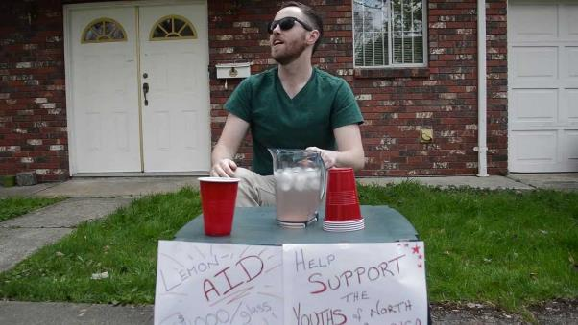
Take a look at this spoof film (1.51 mins) exploring some of negative ideas around Voluntourism entitled:
End Humanitarian Douchery
(click on the link)

Slide 17
What are some of the main messages that this film is trying to show?

Slide 18
Is the project sustainable?
Is the project working in collaboration/ harmony with the local community?
Before you volunteer overseas, find out:
Do I have the skills required for this placement?
Am I being encouraged to research local customs, language and traditions before I arrive?
Is there a long-term goal to achieve using short-term voluntary aid?
Where is my money going? (if it is a paid placement)
Will I be putting someone out of a job if I take this placement?

Slide 19
VOLUNTOURISM
T H I S S O R T O F L E A R N I N G
C A N ’ T W A I T

