Slide 1
15 minutes+
Voluntourism
Week 2 – Looking beyond the self(ie)
Y7&8
11-13 years

Slide 2
In this lesson, students will:
THINK!
Think about and discuss some of the benefits and ripple effects that come when volunteering overseas.
Understand how our choices affect many people who we will never see, and understand the need for being conscious of the wider ripple effects of our own actions
Explore and unravel some of the consequences of Voluntourism upon communities and re-think new approaches
FEEL!
UNLEARN!

Slide 3
Pre-lesson reflection
3 minutes+

Slide 4
Introduce the following REFLECTIVE QUESTIONS for students to consider during the lesson:
What is the attraction of volunteering overseas?
What are some of the common volunteering opportunities that exist for young people in overseas projects?
Why do you often not require any skills in these industries when volunteering overseas?
Why might we take a different attitude to volunteering when it is in another country?

Slide 5
Looking beyond ourselves 5 minutes+

Slide 6
Watch the short spoof film (1.27mins) made by Norwegian organisation SAIH entitled:
How to get more like on Social Media
(Click on the link above for the hyperlink)

Slide 7
Allow students a few minutes to respond to the film with people sitting near to them.
After sharing their initial responses, ask them to consider the following questions:

Slide 8
What lessons can we take away from this campaign?

Slide 9
Humanitarian Douchery 10 minutes+

Slide 10
Voluntourism is now a multi-million pound industry, attracting more and more people every year. But who is Voluntourism benefiting the most?
The middle-man (the person who organises the placement)
The local community?
The volunteer?

Slide 11
Talk about each person and think about how they might benefit from Voluntourism and also how (if at all) it might negatively impact them.
The middle-man (the person who organises the placement)
The volunteer?
The local community?

Slide 12
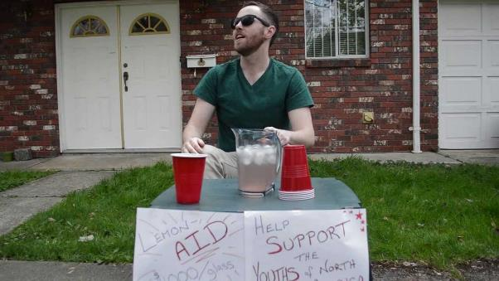
Take a look at this spoof film (1.51 mins) exploring some of negative ideas around Voluntourism entitled:
End Humanitarian Douchery
(click on the link)

Slide 13
What are some of the main messages that this film is trying to show?

Slide 14
Is the project sustainable?
Is the project working in collaboration/ harmony with the local community?
Before you volunteer overseas, find out:
Do I have the skills required for this placement?
Am I being encouraged to research local customs, language and traditions before I arrive?
Is there a long-term goal to achieve using short-term voluntary aid?
Where is my money going? (if it is a paid placement)
Will I be putting someone out of a job if I take this placement?

Slide 15
To explore some of the more negative ripple effects of Voluntourism you can: Read a short article from the Huffington Post called “What could go wrong when trying to do right?”:
http://www.huffingtonpost.com/daniela-papi/voluntourism_b_1525532.html
Listen to a fifteen minute podcast called “The Problem with Volunteering”
http://www.bbc.co.uk/programmes/b01s4qr7

Slide 16
ThoughtBox: This sort of learning can’t wait

