Slide 1
HAPPINESS
CULTURAL IDENTITY
Y7&8
11-13 years

Slide 2
M O N E Y C A N ‘ T B U Y
W E E K 2
3 0 M I N U T E S

Slide 3
In this lesson, students will:
THINK!
Think about and discuss the link between money and happiness
Understand how some countries are using happiness as a measure of how successful people are, rather than money
Explore and unravel the way we are being influenced to think about success and happiness
FEEL!
UNLEARN!

Slide 4
P R E L E S S O N
R E F L E C T I O N S
3 – 5 M I N U T E S +

Slide 5
Introduce the following REFLECTIVE QUESTIONS for students to consider during the lesson:
What is success? Is it the same as happiness?
What is the link between money and success?
What is the link between money and happiness?
What do you think of when you hear the phrase “Money can’t buy happiness”?

Slide 6
T H E G A M E O F
H A P P I N E S S
1 5 M I N U T E S +

Slide 7
Watch the video (6.49 mins) of an interview with former professional footballer Richard Eckersley talking about how his feelings of happiness and understanding of success have drastically changed:
Finding Happiness: Playing a different game
(Click on the hyperlink above)

Slide 8
Allow students a few minutes to respond to the film with people sitting near to them.
After sharing their initial responses, ask them to consider the following questions:

Slide 9
Why do you think people associate fame and fortune with happiness?
Did you agree with Richard and Nicola’s definition of success? Why? Why not?
Is happiness a journey or a destination? Or both? What might this mean?

Slide 10
H O W D O Y O U
M E A S U R E H A P P I N E S S
2 0 M I N U T E S +

Slide 11
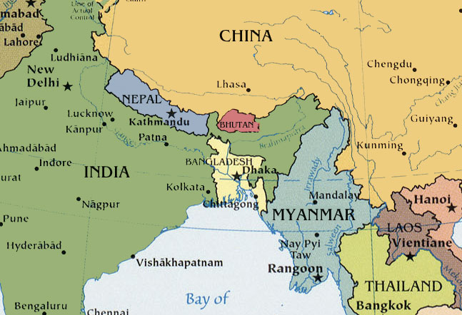
This little country in between China and India is called Bhutan.
It is very famous across the world because it measures its own success as a country not by money but by levels of happiness!

Slide 12
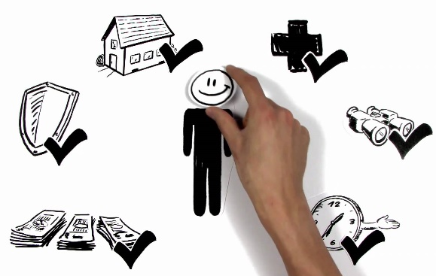
Watch the short video (3.24 mins) made by The Simple Show entitled:
Gross National Happiness
(Click on the hyperlink above)

Slide 13
Allow students a few minutes to respond to the film with people sitting near to them.
After sharing their initial responses, ask them to consider the following questions:

Slide 14
Do you think GNH (*Gross National Happiness) is a positive way for a country to run? Why?

Slide 15
So how does GNH work?

Slide 16
GNH has four main elements:
Sustainable Development
Conservation of the natural environment
Four pillars of GNH
Preservation and promotion of Cultural Values
Establishment of good governance

Slide 17
Look again at the four pillars on the next slide. Split into four groups and ask each group to think about why their pillar might be important for our happiness. Spend a few minutes talking together and then share ideas with the class.

Slide 18
1
Sustainable Development
2 Conservation of the natural environment
Four pillars of GNH
3 Preservation and promotion of Cultural Values
4 Establishment of good governance

Slide 19
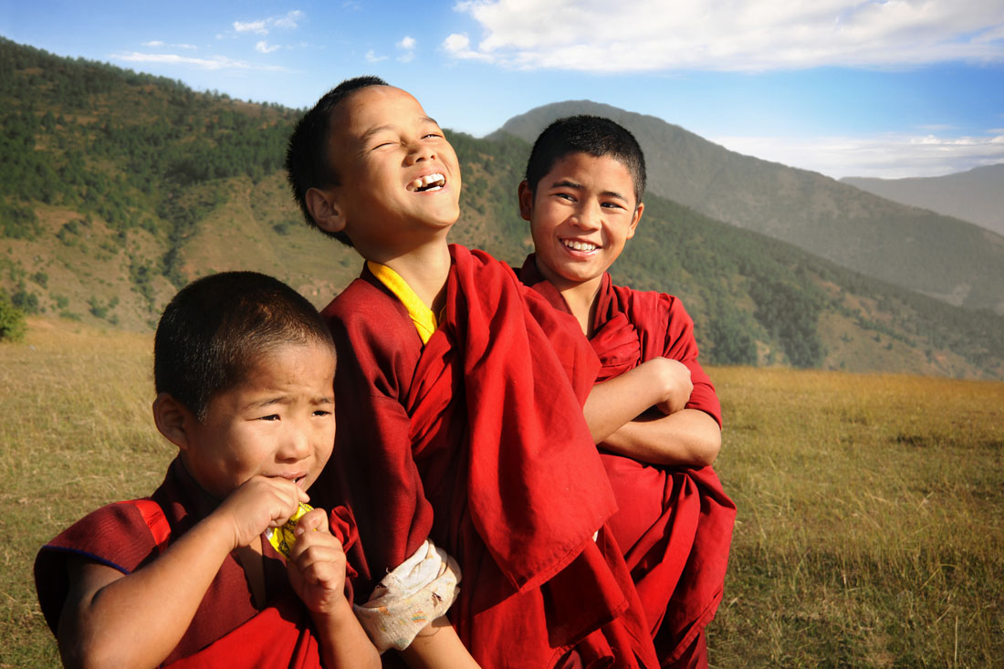
How does it work?
Within these four main categories, GNH has nine key domains which are measured.
These nine key components are key to the happiness in Bhutan.
Each is considered to be equally important as a component of gross national happiness.

Slide 20
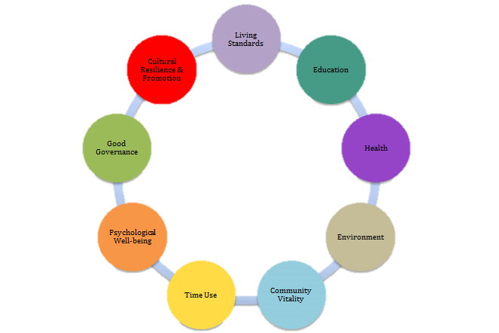
9 key elements of GNH

Slide 21
Look at each of these and think about how important it is to your happiness.
Psychological wellbeing
Health
Time use
Education
Cultural resilience and promotion
Good Governance
Community vitality
Environment (Ecological diversity and resilience)
Living standards
Try and rank them in order of importance to your own happiness.

Slide 22
Want to take the GNH survey?
Click here to access the 2015 Gross National Happiness (GNH) questionnaire given to all citizens of Bhutan to measure their happiness!

Slide 23
Happiness is a very different thing to every person, and therefore it might seem rather hard to measure. Although we all agree on a few fundamentals, it is a very subjective “state of mind” for a lot of us.
Ask students to think about how to measure the happiness levels of the class.
Split into small groups and ask each group to discuss ideas and questions for measuring how happy their class is.
Some key questions to consider are on the following slide:

Slide 24
What sort of questions should we ask?
How can we measure the results?
How can we ensure people give their true answers?
Should we use categories like the GNH?

Slide 25
H A P P I N E S S
T H I S S O R T O F L E A R N I N G
C A N ’ T W A I T

