Slide 1
HAPPINESS
CULTURAL IDENTITY
Y7&8
11-13 years

Slide 2
M I N D Y O U R H E A D
W E E K 3
6 0 M I N U T E S

Slide 3
In this lesson, students will:
THINK!
Think about and discuss some of the stigma surrounding mental health and how we all need to take good emotional care of ourselves
Understand some of the causes of mental health issues for young people and think about how using mindfulness and meditation can support our emotional health
Explore and unravel some of the stigma and stereotypes surrounding mental illness which prevents us from discussing our negative emotions
FEEL!
UNLEARN!

Slide 4
P R E L E S S O N
R E F L E C T I O N S
3 – 5 M I N U T E S +

Slide 5
Introduce the following REFLECTIVE QUESTIONS for students to consider during the lesson:
Do you feel emotionally healthy?
If not, do you know why not?
Do you have support with any mental health worries in your school and community?
Should schools be doing more to support positive emotional health in young people?

Slide 6
U N D E R S T A N D I N G
O U R A N X I E T Y
2 0 M I N U T E S +

Slide 7
Watch the short film (6.40 mins) made by mental health organisation Mind entitled:
In our own words
(Click on the hyperlink above)

Slide 8
Allow students a few minutes to respond to the film with people sitting near to them.
After sharing discuss together the following questions:

Slide 9
Why is there a stigma surrounding mental health, do you think?
What role do you think schools should play in supporting mental health?
Is your school doing enough do you think? Why? Why not?

Slide 10
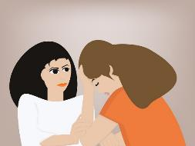
As young people face ever-growing number of pressures both in and out of school, cases of mental health problems are on the rise.
There are many factors triggering the rise in levels of anxiety, depression and self-harm amongst young people, and being aware of these triggers is just one part of understanding how to support yourself and others in difficult times.

Slide 11
Split the class into small groups of 4 or 5 and give each group a piece of paper.
Spend five minutes brainstorming all of the key pressure points that exist for young people that may increase levels of anxiety or mental health issues.
An example can be found on the next slide.

Slide 12
Social media
?
Exam stress
Causes of stress and anxiety
?
Peer pressure
?
Home life pressure
?

Slide 13
Share ideas together and make a list on the board of the key causes of anxiety and stress for young people.
Now (on your own rank) the list in order of most significant to least significant, thinking about which of these cause you the greatest amount of stress or anxiety in your life right now.
For example:
1. Exam pressure *the most stressful thing in my life right now
2. Social media pressure *the second most stressful thing in my life right now
3. Home life pressure
4. Relationships

Slide 14
What do you think should change to stop young people having such high levels of anxiety and stress?
Talk to the person next to you and see if you can share ideas for preventing such high levels of stress.

Slide 15
L E A R N I N G T O B E
E M O T I O N A L L Y
H E A L T H Y
2 0 M I N U T E S +

Slide 16
Hand out a piece of paper to each student and ask them to answer the following questions six questions about their current levels of happiness, anxiety and stress.
NB: these are private, personal responses and will not be shared with anyone, they are just for themselves.

Slide 17
How happy are you in school, on a scale of 1-10?
What are some of the things stopping you from being happy right now?
Which of these things do you have direct control over or could change?

Slide 18
What could make you happier in school?
Do the pressures from school or college increase your levels of anxiety and/or happiness?
What are the key areas within your school or college that increase levels of anxiety and/ or suppress levels of happiness?

Slide 19
Should we teach about emotions at school?
If so, how do you think emotions could (or should) be taught?

Slide 20
Anxiety has been on the rise within schools for the past ten years, and many schools are now teaching happiness. Wellington College, in Berkshire, England is most famous for this, as well as Harvard University in America.
Should this now be a vital part of school curriculums do you think? Why?

Slide 21
If time and interest allow, the following links give some information about why schools and universities are teaching well-being and happiness:
Click here to Wellington College’s explanation as to why Happiness is on the curriculum.
Click here to read about Harvard University’s over-subscribed Happiness course.

Slide 22
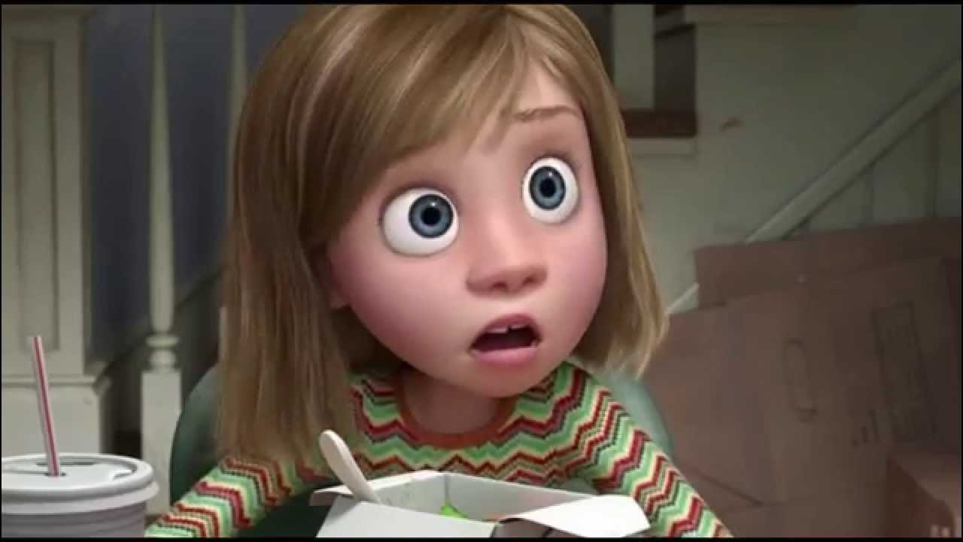
Disney Pixar's animated movie Inside Out takes a thoughtful look at emotions and mental wellbeing, and how this affects one family (in particular a young teenager called Riley).
The film goes inside the mind, showing how our emotions control much of what we are doing. It is a clever way of explaining to children that about how your mind copes with life and there is nothing wrong with feeling the way we feel - whether happy or sad angry or fearful or disgusted. These emotions are important to make us human.

Slide 23
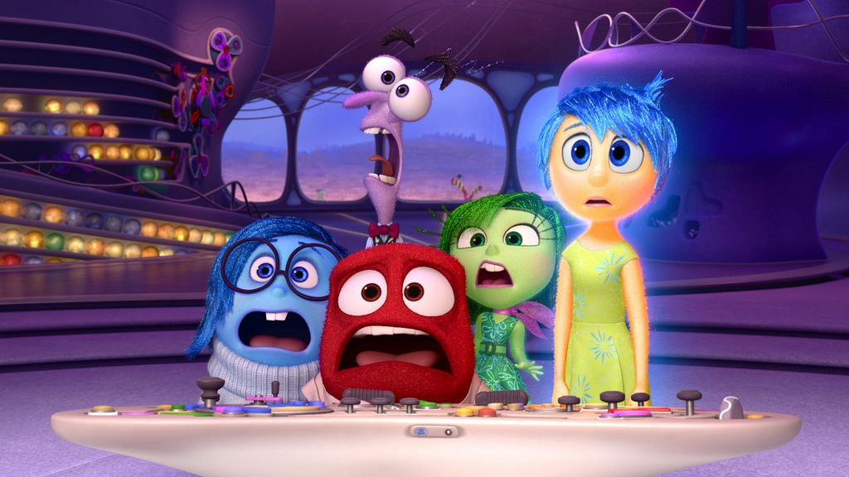
Watch the short video (2.32mins) put together by The Creative Mind using clips from the film entitled:
Inside out and emotional health
(Click on the hyperlink above)

Slide 24
Allow students a few minutes to respond to the film with people sitting near to them.
Now discuss the following questions together as a class:

Slide 25
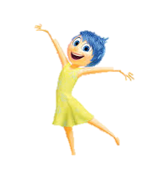
Do you think it is important to talk about our emotions?
Why do many people find it difficult to talk about how they feel?

Slide 26
L E A R N I N G T O B E
M I N D F U L
1 5 M I N U T E S +

Slide 27
What is ‘mindfulness’? Have you heard of this practice before?
Talk with the person next to you and see if you can come up with a definition for ‘Mindfulness’. Share your ideas with the class.

Slide 28
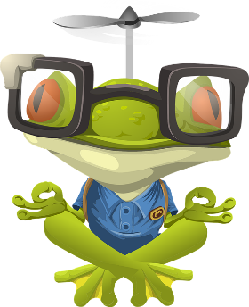
Mindfulness is the basic human ability to be fully present, aware of where we are and what we’re doing, and not overly reactive or overwhelmed by what’s going on around us.

Slide 29
Many schools across the world are now using mindfulness and meditation to support well-being amongst students. The idea is to give students time to breathe, to practice being calm when they feel stressed and to support them in developing tools for a happier life.
Take a look at the following three initiatives in schools and discuss whether you think these are positive ideas. Either break the class up into small groups and give each group an initiative to research and feedback on, or look at them all together as a group.

Slide 30
1. Mindfulness detentions | 2. The Peace Button | 3. Happiness lessons
https://www.youtube.com/watch?v=Adg-S2hY07w | https://www.youtube.com/watch?v=YrA-z3GTn40 | https://www.wellingtoncollege.org.uk/pastoral-care/well-being/

Slide 31
1. Mindfulness detentions
https://www.youtube.com/watch?v=Adg-S2hY07w
Instead of punishing disruptive kids or sending them to the principal's office, this school in Baltimore, USA, has something called the Mindful Moment Room instead.
Find out more here.

Slide 32
2. The Peace Button
https://www.youtube.com/watch?v=YrA-z3GTn40
Peace Button has a mission to empower children worldwide by imparting a mindfulness method using their belly button and a chant: Peace Inside = Peace Outside = Peace in The World
Find out more here.

Slide 33
3. Happiness lessons
https://www.wellingtoncollege.org.uk/pastoral-care/well-being/
Wellington College was the first school in the UK to introduce a course in happiness and well-being in 2006 and it has gone from strength to strength, inspiring schools across the world.
Find out more here.

Slide 34
Is it a positive idea to teach young people mindfulness? Why?
Does your school do enough to support emotional learning do you think?

Slide 35
R E M O V I N G T H E
S T I G M A
1 0 M I N U T E S +

Slide 36
People with mental health problems say that the social stigma attached to mental ill health and the discrimination they experience can make their difficulties worse and make it harder to recover.
What are some of the stereotypes and negative ideas associated with mental health?

Slide 37
Pupils are taught from a young age how to take care of their bodies, but looking after their minds often comes later, if at all.
Young people need to be aware that things will sometimes / often go wrong – and that’s OK. Resilience is, undoubtedly, one of the most valuable skills we can develop. However, we are often not taught to be resilient or to deal with failure at school.

Slide 38
Why do you think many of us are not taught about dealing with failure at school? Should we be?

Slide 39
Watch the short film (1.58 mins) made for Heads-Up as an advert by Mental Health Awareness entitled:
We all have problems
(Click on the link above for the hyperlink)

Slide 40
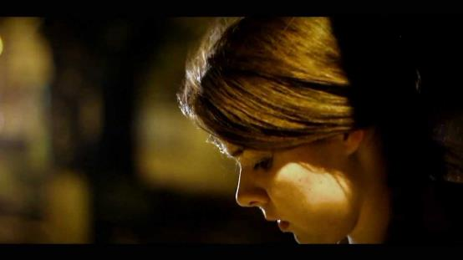
Allow students a few minutes to respond to the film with people sitting near to them.
After sharing their initial responses, ask them to think about the following questions:

Slide 41
Think about whether you recognise any of the feelings in the film
Think about who you turn to when you have anxiety
Think about what some of the main causes of your anxiety are

Slide 42
Should we teach about emotions at school?
Talk with the person next to you for a few minutes and then share ideas with the class.

Slide 43
T A K E I T F U R T H E R

Slide 44
Take it further:
Look at the following article exploring some of the arguments for why we should start teaching emotions at school.

Slide 45
Should emotions be taught at school?
By Grace Rubenstein
Who taught you how to identify and manage your emotions, how to recognize them when they arose, and how to navigate your way through them? For many adults, the answer is: No one. You hacked your way through those confusing thickets on your own.
Although navigating our inner landscape was not something that was taught to us in school, it should be, contend a number of researchers. They believe emotional skills should rank as high in importance in children’s educations as math, reading, history and science.

Slide 46
Why do emotions matter? Research has found that people who are emotionally skilled perform better in school, have better relationships, and engage less frequently in unhealthy behaviours. Plus, as more and more jobs are becoming mechanized, so-called soft skills — which include persistence, stress management and communication — are seen as a way to make humans irreplaceable by machine.
There has been a growing effort in American schools to teach social and emotional learning (SEL), but these tend to emphasize interpersonal skills like cooperation and communication.

Slide 47
Kids are often taught to ignore or cover over their emotions. Many Western societies view emotions as an indulgence or distraction, says University of California-Santa Barbara sociologist Thomas Scheff, a proponent of emotional education. Our emotions can give us valuable information about the world, but we’re often taught or socialized not to listen to them. Just as dangerous, Scheff says, is the practice of hiding one emotion behind another. He has found that men, in particular, tend to hide feelings of shame under anger, aggression and, far too often, violence.

Slide 48
How does one go about teaching emotions? One of the most prominent school programs for teaching about emotions is RULER, developed in 2005 by Marc Brackett, David Caruso and Robin Stern of the Yale Centre for Emotional Intelligence.
The multiyear program is used in more than 1,000 schools, in the US and abroad, across grades K-8. The name, RULER, is an acronym for its five goals: recognizing emotions in oneself and others; understanding the causes and consequences of emotions; labelling emotional experiences with an accurate and diverse vocabulary; and expressing and regulating emotions in ways that promote growth.

Slide 49
As a strategy, children are taught to focus on the underlying theme of an emotion rather than getting lost in trying to define it. When an emotion grips you, explains Stern, understanding its thematic contours can help “name it to tame it.”
Even though anger is experienced differently by different people, she explains, “the theme underlying anger is the same. It’s injustice or unfairness. The theme that underlies disappointment is an unmet expectation. The theme that underlies frustration is feeling blocked on your way to a goal. Pinning down the theme can “help a person be seen and understood and met where she is,” says Stern.

Slide 50
RULER’s lessons are woven into all classes and subjects. So, for example, if “elated’ is the emotional vocabulary word under discussion, a teacher would ask students in an American history class to link “elated” to the voyage of Lewis and Clark. Instruction reaches beyond the classroom, too; kids are prompted to talk with their parents or caregivers about when they last felt elated.
Researchers at the Yale Centre for Emotional Intelligence has found RULER schools tend to see less-frequent bullying, lower anxiety and depression, more student leadership and higher grades. So why isn’t emotional education the norm rather than the exception?

Slide 51
Surprising fact: While scientists and educators agree on the need to teach emotions, they don’t agree on how many there are and what they are. RULER’s curriculum consists of hundreds of “feeling words,” including curious, ecstatic, hopeless, frustrated, jealous, relieved and embarrassed.
Other scholars’ lists of emotions have ranged in number from two to eleven. Scheff suggests starting students out with six: grief, fear, anger, pride, shame and excessive fatigue.

Slide 52
While psychology began to be studied as a science more than a century ago, up to now it has focused more on identifying and treating disorders. Scheff, who has spent years studying one taboo emotion — shame — and its destructive impact on human actions, admits, “We don’t know much about emotions, even though we think we do, and that goes for the public and for researchers.”
Or, as Virginia Woolf so beautifully put it, “The streets of London have their map; but our passions are uncharted.”

Slide 53
Parents can start to encourage their kids’ emotional awareness with a simple prompt “Tell me about some of your best moments,” a phrase Scheff has used to initiate discussions with his university students.
But he and Stern agree that schools can’t wait until academics have sorted out the name and number of emotions before they act. “We know we have emotions all day long, whether we’re aware of them or not,” Stern points out. Let’s teach kids how to ride those moment-by-moment waves, instead of getting tossed around.
Author Grace Rubenstein is a journalist, editor and multimedia producer in California. The article is from http://blog.ed.ted.com/2017/02/24/should-emotions-be-taught-in-schools/

Slide 54
H A P P I N E S S
T H I S S O R T O F L E A R N I N G
C A N ’ T W A I T

