Slide 1
15 minutes+
Faith
Week 4 – Challenging the Universe
Y7&8
11-13 years

Slide 2
In this lesson, students will:
Think about and explore our place in the universe
Understand how some of our societal pressures require us to step beyond religion and come together in new ways
Explore and unravel how we can move beyond religious boundaries and difference and think about ways to support a cohesive future

Slide 3
Pre-lesson reflection 3-5 minutes+

Slide 4
Introduce the following REFLECTIVE QUESTIONS for students to consider during the lesson (maybe write them up or read them aloud and ask students to think about their own responses):
What does ‘spirituality’ mean?
Do you ever think about the universe and your place within it?
What are some of the arguments that exist between religion and science?

Slide 5
We are here 15 minutes+

Slide 6
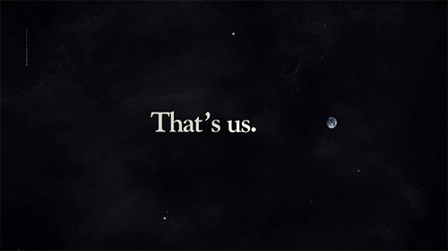
Watch the short video (3.53mins) made by Astrophysicist and author Carl Sagan entitled:
The Pale Blue Dot
(Click on the link above for the hyperlink)

Slide 7
Allow students a few minutes to respond to the film with people sitting near to them.
After sharing their initial responses, ask them to think about the following questions:

Slide 8
What is the universe? How do help yourself to understand it?
Do you like thinking about the universe? Why? Why not?
How does faith help people to understand the universe and their place within it?

Slide 9
The idea of the universe is one that a lot of people – adults included - have a difficult time understanding and many people do not like thinking about it.
Why do you think this might be?

Slide 10
Because there is no “one answer” to what it means to be human and what the universe is, many people find their own answers – some use religion, some use science, some have their own thoughts and beliefs.
What about you?
Do you have your own ideas (or a religious belief) that help you to understand a little bit about the universe and our place in it?

Slide 11
Spend five minutes on your own writing down (or drawing) your thoughts about the universe and your place in it.
What about you?
If students are happy, share ideas with the class or maybe use the work to make a display for the classroom.

Slide 12
To finish, look at the advice from the British Council on ways to celebrate diversity of faith and think about whether you could encourage any of these into your school:
Nine Ways to Celebrate Diversity.

Slide 13
This sort of learning can’t wait
www.thoughtboxeducation.com

