Slide 1
15 minutes+
Voluntourism
Week 4 – Bottoms Up
Y7&8
11-13 years

Slide 2
In this lesson, students will:
THINK!
Think about and discuss some of the merits ethical volunteering and grass roots support
Understand how working with communities and local areas is key to a positive relationship and how positive global citizenship can have positive ripple effects
Explore and unravel some of the harmful and negative stereotypes perpetuated by charity campaigns and understand how to counteract these with ethical, sustainable approaches to aid
FEEL!
UNLEARN!

Slide 3
Pre-lesson reflection
3 minutes+

Slide 4
Introduce the following REFLECTIVE QUESTIONS for students to consider during the lesson:
What does it mean for an organisation to be “grass roots”?
What does it mean to be an ethical organisation and an ethical volunteer?
How can we learn to practice global citizenship through ethical travel, tourism and volunteering?

Slide 5
Bottoms Up 10 minutes+

Slide 6
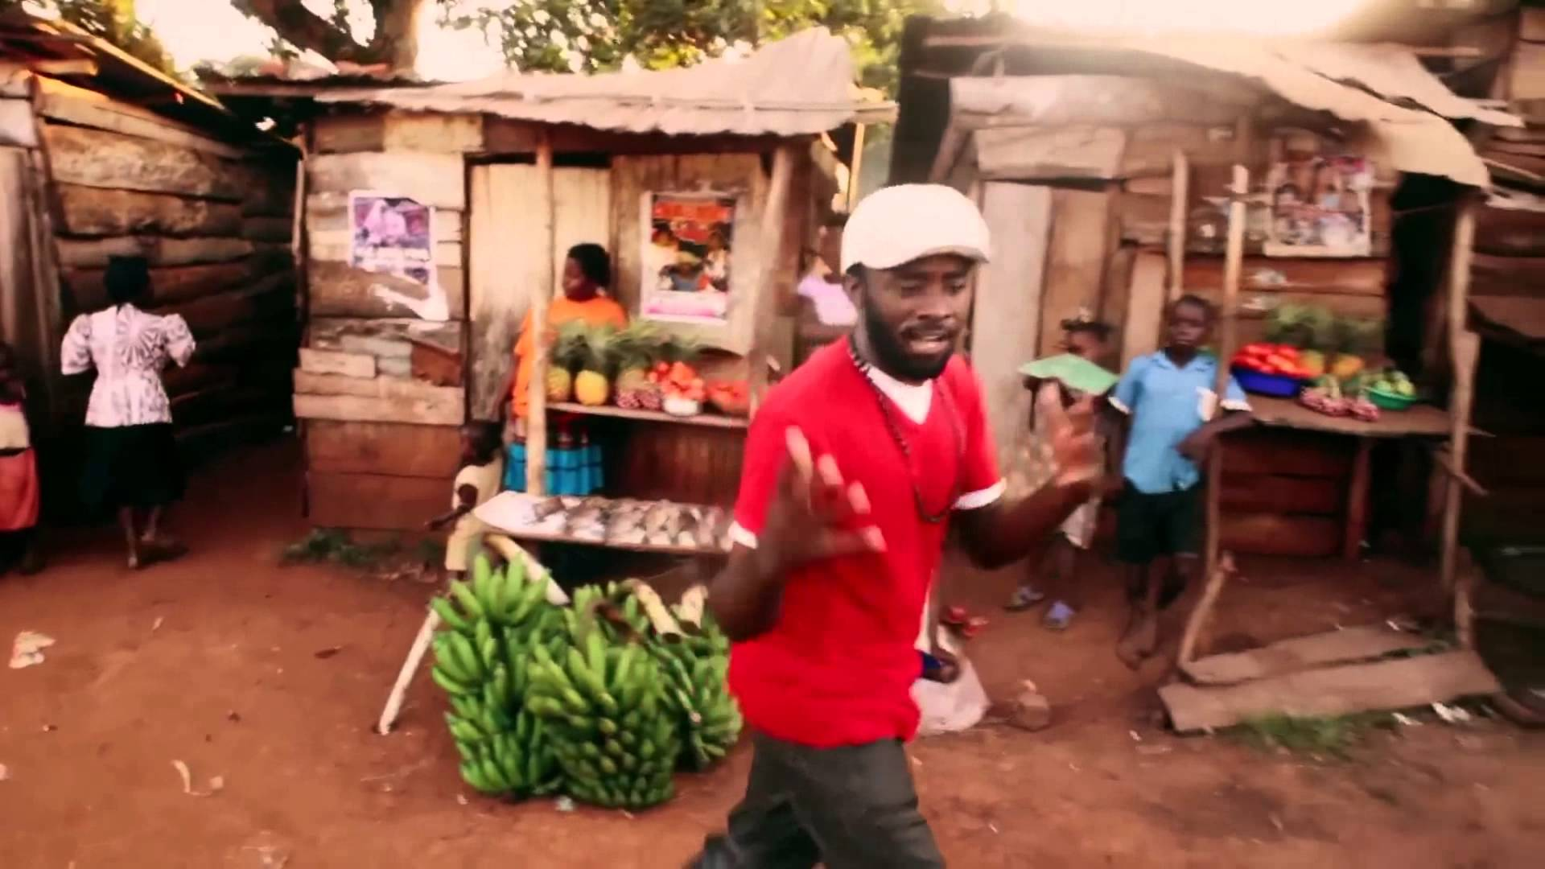
Watch the short music video (4.40mins) made by Ugandan Microfinance organisation SYPO entitled:
Price Tag
Click on the link above for the hyperlink

Slide 7
Allow students a few minutes to respond to the film with people sitting near to them.
After sharing their initial responses, ask them to consider the following questions:

Slide 8
How is this video challenging some of the traditional “top down” charity campaigns?

Slide 9
Organisations that offer aid through “top-down” action are often failing to listen to the needs of the community.
Some charities work by “deciding” what an area or a community might need, and then working to give this to them, rather than actually asking first.
In some cases this sort of aid is actually disrespecting the cultural values, traditions and human dignity of the people they are trying to “help”.

Slide 10
Remind yourself:
What does it mean to have a “top down” approach to international aid?
Why is a “bottom up” or “grass roots” approach much more sustainable?

Slide 11
Look at these two approaches to how charities are working in other countries.
3.Work with the community
2.Talk with other organisations to discuss ways to support the problem
1.Local community identify a problem and ask for help
1. Assume or identify a problem in another country or community
2.Make a plan to fix it or how you can help
3. Go and help

Slide 12
To understand whether an organisation, campaign or initiative is something positive to support (whether by volunteering your time or your money) it is important to be able to understand what a negative organisation may look like.

Slide 13
Understanding if a charity or aid organisation is negative:
Look out for the promotion of negative stereotypes
Be careful of organisations that are using a top-down approach
Avoid organisations that are not sustainable (e.g. when you leave the work does not continue)
Stay away from organisations that are not working together with the communities that they are supporting.

Slide 14
Watch the following media campaign from Comic Relief. The organisation and advert are trying to do a good thing, but in some ways falling short.
CAMPAIGN 1 – Comic Relief
Ed Sheeran visits Liberia
(click on the link to watch the film)

Slide 15
Explore the intention behind the advertisement.
Is it a sustainable campaign? Why?
Watch the advert and think about the negative elements that seen witin the advertisement
If time, find out more about the campaign: research what it is trying to do, how it works, who is behind it and the positive/negative elements

Slide 16
Discuss with the person next to you and then feedback to the class ways in which the campaign was:
Not bottom up / not working with the community
Not sustainable
Promoting the “white saviour” rhetoric

Slide 17
Be a positive Voluntourist 5 minutes+

Slide 18
Being able to travel ethically is a useful (and many would argue integral) part of any trip or exploration, especially when going overseas.
Beyond that, being able to volunteer in an ethical and sustainable organisation is perhaps the most positive type of volunteering that we can do; whether at home or abroad.

Slide 19
What does “ethical” mean when used in relation to a volunteer project?
What does “sustainable” mean when used in relation to a volunteer project?

Slide 20
Volunteering time can be a very positive contribution to offer the world and it is important to remember that this really can be a good thing to do. HOWEVER it is also important to understand that we all have a responsibility to do it well.
If volunteering is an option, we have a responsibility to choose a good organisation, project or company to volunteer with – a project that is both ETHICAL and SUSTAINABLE.
Research, planning and critical thinking are key skills here!

Slide 21
For more information, here are a range of articles exploring some of the criteria for ethical travel as well as the importance of ethical volunteering:
Ethical Travel Guide
Better Volunteering Better Care Network (30 articles)
Beyond the emotional fundraising adverts
Seven worst international aid ideas

Slide 22
ThoughtBox: This sort of learning can’t wait

