Slide 1
30 minutes+
Faith
Week 4 – Challenging the Universe
Y7&8
11-13 years

Slide 2
In this lesson, students will:
Think about and explore our place in the universe
Understand how some of our societal pressures require us to step beyond religion and come together in new ways
Explore and unravel how we can move beyond religious boundaries and difference and think about ways to support a cohesive future

Slide 3
Pre-lesson reflection 3-5 minutes+

Slide 4
Introduce the following REFLECTIVE QUESTIONS for students to consider during the lesson (maybe write them up or read them aloud and ask students to think about their own responses):
What does ‘spirituality’ mean?
Do you ever think about the universe and your place within it?
What are some of the arguments that exist between religion and science?

Slide 5
We are here 20 minutes+

Slide 6
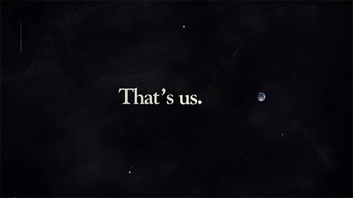
Watch the short video (3.53mins) made by Astrophysicist and author Carl Sagan entitled:
The Pale Blue Dot
(Click on the link above for the hyperlink)

Slide 7
Allow students a few minutes to respond to the film with people sitting near to them.
After sharing their initial responses, ask them to think about the following questions:

Slide 8
What is the universe? How do help yourself to understand it?
Do you like thinking about the universe? Why? Why not?
How does faith help people to understand the universe and their place within it?

Slide 9
The idea of the universe is one that a lot of people – adults included - have a difficult time understanding and many people do not like thinking about it.
Why do you think this might be?

Slide 10
Because there is no “one answer” to what it means to be human and what the universe is, many people find their own answers – some use religion, some use science, some have their own thoughts and beliefs.
What about you?
Do you have your own ideas (or a religious belief) that help you to understand a little bit about the universe and our place in it?

Slide 11
Spend five minutes on your own writing down (or drawing) your thoughts about the universe and your place in it.
What about you?
If students are happy, share ideas with the class or maybe use the work to make a display for the classroom.

Slide 12
Tomorrow together? 10 minutes+

Slide 13
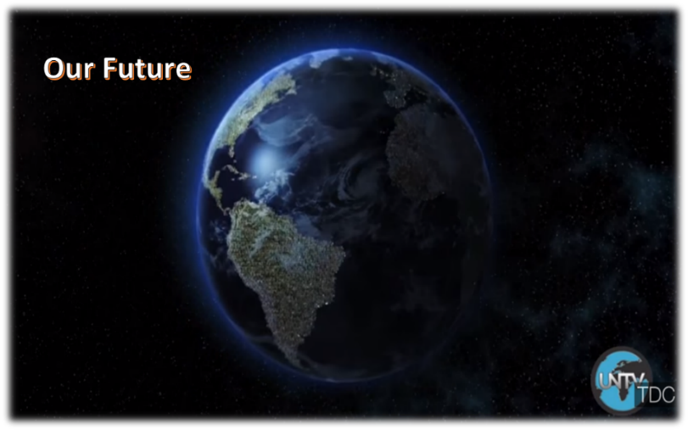
Watch the short video (3.37 mins) made by The United Nations entitled:
Our Future
(Click on the link above for the hyperlink)

Slide 14
Allow students a few minutes to respond to the film with people sitting near to them.
After sharing their initial responses, ask them to think about the following questions:

Slide 15
How is this film trying to encourage us all to come together, despite of our differences?
How might climate change encourage religious tolerance?

Slide 16
Over the past few years, many world leaders have made bold statements about the need for humans to come together, despite our differences, to act for the good of the planet, rather than the good of individual groups or countries.
Many world leaders (including the Pope) have even said that “climate change is bigger than religion” and that we have to come together to stop our destruction of the earth.
Look at the following presentation entitled “Is Climate Change Bigger Than Religion” and discuss some of the ideas and questions that come up.

Slide 17
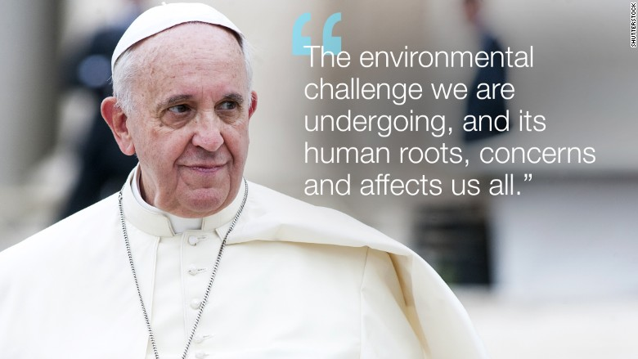
The presentation shows small extracts taken from a letter written by Pope Francis, Head of the Catholic church. This is just one example of a religious leader proclaiming the need for people to look beyond their faith in order to tackle some of the pressing issues facing us all.

Slide 18
Is climate change bigger than religion?

Slide 19
Below are some excerpts from Pope Francis’s encyclical (letter) about Climate Change
Read each point and think about how the message might be trying to encourage religious tolerance by asking us all to come together for the good of the planet.

Slide 20
1) Climate change has grave implications.
“Each year sees the disappearance of thousands of plant and animal species which we will never know, which our children will never see, because they have been lost forever,” he writes.

Slide 21
2) Rich countries are destroying poor ones, and the earth is getting warmer.
“The warming caused by huge consumption on the part of some rich countries has repercussions on the poorest areas of the world, especially Africa, where a rise in temperature, together with drought, has proved devastating for farming.”

Slide 22
3) Christians have misinterpreted Scripture
and “must forcefully reject the notion that our being created in God’s image and given dominion over the earth justifies absolute domination over other creatures.”

Slide 23
4) The international community has not acted enough
“Recent World Summits on the environment have not lived up to expectations because, due to lack of political will, they were unable to reach truly meaningful and effective global agreements on the environment.”

Slide 24
5) Why are we here on Earth in the first place?
“What kind of world do we want to leave to those who come after us, to children who are now growing up?” he writes.

Slide 25
Thinking about some of the reasons that the Pope (and many other religious leaders) are outlining to encourage us to come together, discuss your responses to the following question:
Do you think that climate change is a force that can enable us to be more tolerant of religious differences?

Slide 26
Celebrating difference 5 minutes+

Slide 27
To finish, look at the advice from the British Council on ways to celebrate diversity and think about whether you could encourage any of these into your school:
Nine Ways to Celebrate Diversity.

Slide 28
This sort of learning can’t wait
www.thoughtboxeducation.com

