Slide 1
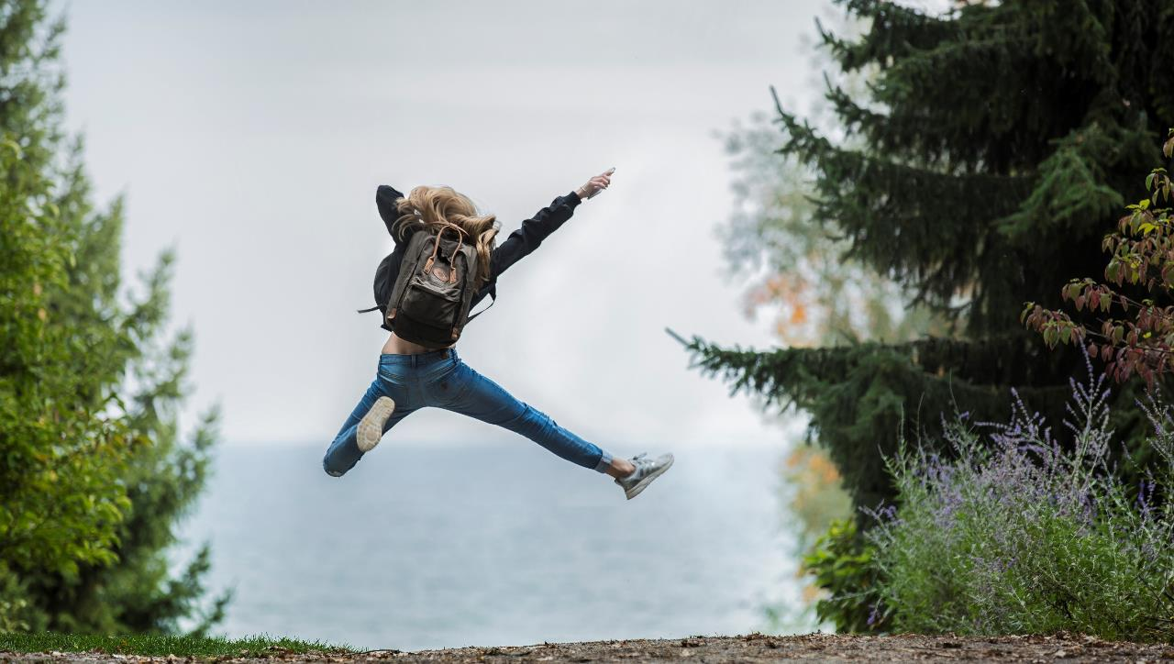
HAPPINESS
CULTURAL IDENTITY
Y7&8
11-13 years

Slide 2
G L A S S H A L F F U L L
W E E K 4
3 0 M I N U T E S

Slide 3
In this lesson, students will:
THINK!
Think about and discuss what we can do to find happiness in our lives and how we can learn to build a positive mind-set
Understand the choices we have when searching for and finding happiness and some of the obstacles that we may face
Explore and unravel some of the barriers that stand in the way to our happiness and understand how to move through them
FEEL!
UNLEARN!

Slide 4
P R E L E S S O N
R E F L E C T I O N S
3 – 5 M I N U T E S +

Slide 5
Introduce the following REFLECTIVE QUESTIONS for students to consider during the lesson:
Do you think you know what it takes to be happy?
Do you think you can learn to help shape your own happiness?
What stands in the way the most of your happiness right now?

Slide 6
T H E H A P P I N E S S
E Q U A T I O N
1 5 M I N U T E S +

Slide 7
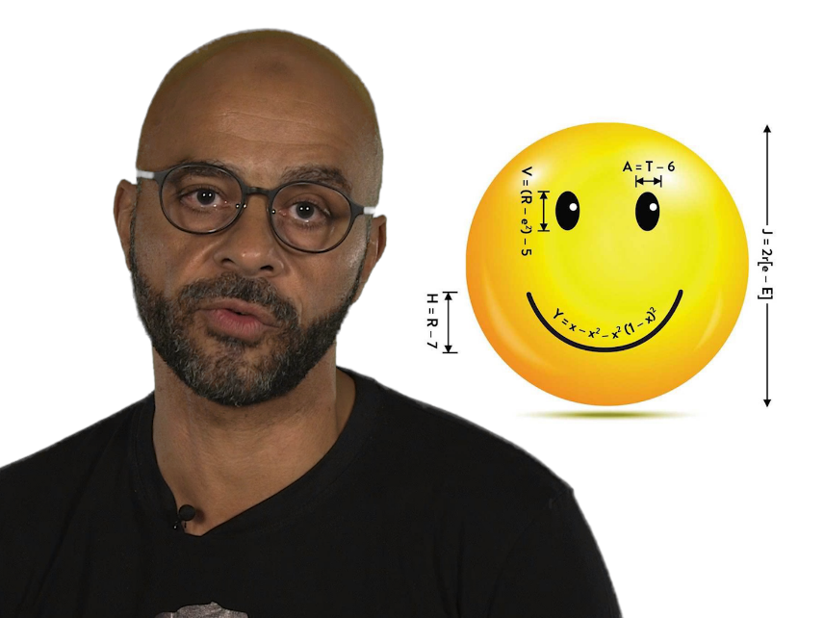
Watch the short video (2.17 mins) made by Google researcher Mo Gawdat entitled:
The Happiness Equation
(Click on the hyperlink above)

Slide 8
Allow students a few minutes to respond to the film with people sitting near to them.
After sharing their initial responses, ask them to read the following statements made by Mo in the film:

Slide 9
If you have low expectations you are mostly going to be happy
What do you think about this idea? Is this a positive framework to adopt for a happy life? Talk with the person next to you and then share ideas with the group.

Slide 10
Look at the “equation for happiness” on the next slide is this a useful idea do you think? Why?

Slide 12
A H A P P Y B R AI N
1 0 M I N U T E S +

Slide 13
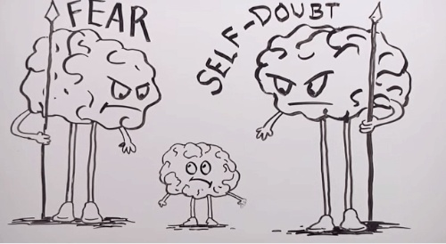
Watch this video (4.23 mins) by Professor of Medicine Dr Sood entitled:
A very happy brain
(Click on the hyperlink above)

Slide 14
Allow students a few minutes to respond to the film with the person next to them.

Slide 15
Finding Happiness using ‘The Three C’s’

Slide 16
All of the points, advice, information and guidance that have been explored throughout this topic come down to just three elements:
Creating!
Connecting!
Caring!
If you encourage these things in your life, you can find ways to allow yourself to feel happy.

Slide 17
So what do you need to do to be happy?

Slide 18
B E C O M I N G A
R A K T I V I S T
1 0 M I N U T E S +

Slide 19
To finish, take a look at the following website called Random Acts of Kindness which encourages us all to find happiness by carrying out acts of kindness on a regular basis.
Decide as a class if you would like to become Ractivists and take part in the monthly challenges to carry out Random Acts of Kindness.
https://www.randomactsofkindness.org/become-a-raktivist

Slide 20
H A P P I N E S S
T H I S S O R T O F L E A R N I N G
C A N ’ T W A I T

