Slide 1


VOLUNTOURISM
SOCIAL PERSPECTIVES
Y9&10
13-15 years

Slide 2
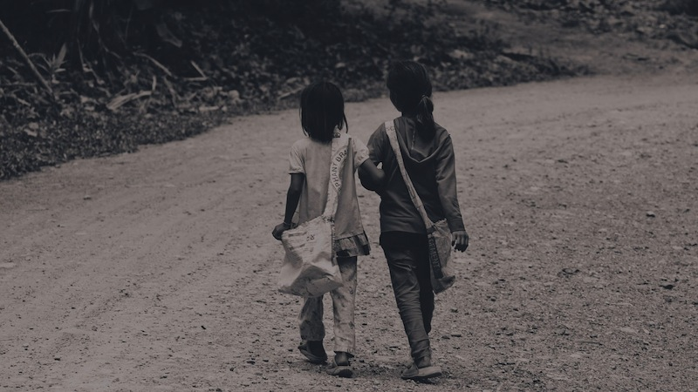
W H O W A N T S T O B E
A V O L U N T E E R?
W E E K 1
30 M I N U T E S

Slide 3
In this lesson, students will:
THINK!
Think about and discuss what volunteering means and explore why many people choose to travel overseas to volunteer
Understand the motivation behind volunteering and explore some of the direct and indirect impacts of our actions
Explore and unravel some of the stereotypes about charities and overseas aid and volunteering that exist, and start to develop a more open-minded approach to the notion of ‘aid’
FEEL!
UNLEARN!

Slide 4
P R E L E S S O N
R E F L E C T I O N S
3 – 5 M I N U T E S +

Slide 5
Introduce the following REFLECTIVE QUESTIONS for students to consider during the lesson:
  What is volunteering? Why do you think so many people choose to volunteer?
  Why is volunteering overseas so popular amongst young people?
  Is volunteering always helpful, do you think? Why?

Slide 6
B E I N G A L T R U I S T I C
1 0 M I N U T E S +

Slide 7

Watch the short video (2.27 mins) made by a global volunteer organisation Pillar Non-Profit entitled:
Youth Volunteering
(Click on the hyperlink above to watch the film)

Slide 8
Allow students a few minutes to respond to the film with people sitting near to them.
After sharing their initial responses, ask them to consider the following questions:

Slide 9

Why do you think people like to volunteer?
Have you ever done any voluntary work? How did you find the experience?

Slide 10
Continue the mind-map and think of all of the reasons that people may choose to volunteer. Include your own experiences and motivation if relevant.
To help others
Why do people volunteer?
Altruism
To share skills
To support those who need
To improve their CV

Slide 11

Does volunteering help ourselves as much as it helps others? What might this mean?
Spend five minutes working in groups of three or four and come up with a list of ideas about ‘self development’ and ideas about ‘supporting others’.
Discuss your response to the question in your group then share with the class.

Slide 12
A R E G O O D
I N T E N T I O N S
G O O D E N O U G H ?
2 0 M I N U T E S +

Slide 13

Watch the following short video (3.06mins) of a person celebrating her 20th Birthday by offering 20 kind acts to strangers:
20 Random Acts of Kindness
(click on the link to watch the film)

Slide 14
Being good to others makes us feel good – it is in a way a positive feedback loop. Kindness feels good, and so the more we are good to others, the more we are good to ourselves.
As a class, discuss together:
Why is kindness infectious?

Slide 15
Read the short article published by the Mental Health Foundation entitled:
Doing good does you good
(click on the link to open the article)
Share ideas and discuss interesting points together after reading

Slide 16
Volunteering overseas has now become very popular, especially within schools and for young people taking gap years.
Many schools and colleges now promote the idea of volunteering overseas, as it is seen to be a good thing for young people to build up their confidence and cultural awareness (and their CV) whilst helping others.

Slide 17
What are some of the reasons people might choose to volunteer overseas?
Does your school offer any links to overseas volunteer projects?

Slide 18

Spend some time talking with the person sitting next to you and see if you can come up with a definition for each of these. What differences are there, if any?
What is a charity? What is an NGO?
Do you know of any charities or NGOs who are working overseas?
Make a list on the board of some of the famous charities that you have heard of e.g. Oxfam.

Slide 19
A charity is an organisation set up to help society in some way, whether that is helping certain groups at home or elsewhere in the world, promoting arts or sport, or helping the environment or animals
An NGO (non-governmental organization) is any non-profit, voluntary citizens' group which is organized on a local, national or international level.

Slide 20


Look at these two approaches to how charities are working in other countries (offering what is called “Development Aid” and see if you can spot the differences.
3.Work with the community
2.Talk with other organisations to discuss ways to support the problem
1.Local community identify a problem and ask for help
1. Assume or identify a problem in another country or community
2.Make a plan to fix it or how you can help
3. Go and help

Slide 21
Which system do you think is likely to be more successful in the long term? Why?
Why do you think charities often use a “top-down” approach rather than a “bottom-up” when working overseas?

Slide 22
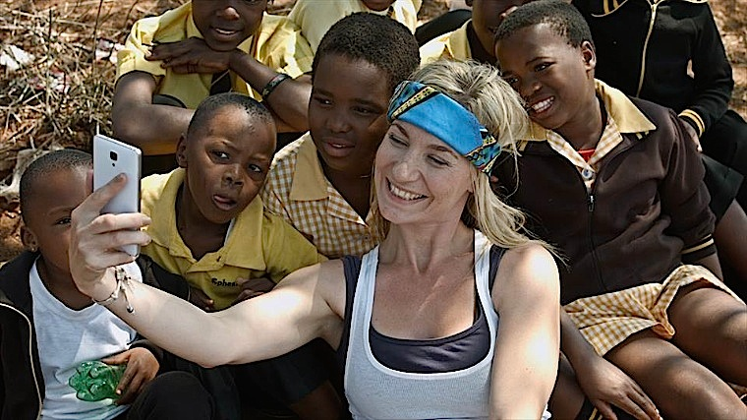
Although the notion of helping others is hugely positive, we are beginning to see some of the problems that come with this sort of volunteering.
Top-down projects is one of them and there is a lot of research happening across the world right now to expose many of the other problems that are coming out of overseas volunteering.

Slide 23
How might some of the following create problems when volunteering overseas?:
Language barriers
Lack of skills in the job
Differences in culture and habits
Short-term volunteering placement
Think about each one and see if you can come up with some issues that may arise

Slide 24
For example, sending unskilled people to work in countries where they don’t know the language or culture, and are working in projects that could employ a local skilled professional instead means that there are negative ripple effects happening because of the project.

Slide 25
Why do you think we don’t often question whether our help is actually helpful when we volunteer?

Slide 26
Think about ways you can pledge to do good in your local community, either by getting involved in some charity work, or doing something really simple and effortless like a random act of kindness.
For inspiration on becoming a RAKtivist (a Random Acts of Kindness –ivist!) explore the ‘Random Acts of Kindness’ website:
https://www.randomactsofkindness.org/

Slide 27
VOLUNTOURISM
T H I S S O R T O F L E A R N I N G
C A N ’ T W A I T

