Slide 1
VOLUNTOURISM
SOCIAL PERSPECTIVES
Y9&10
13-15 years

Slide 2
L O O K I N G B E Y O N D
T H E S E L F I E S
W E E K 2
60 M I N U T E S

Slide 3
In this lesson, students will:
THINK!
Think about and discuss some of the benefits and ripple effects that come when volunteering overseas.
Understand how our choices affect many people who we will never see, and understand the need for being conscious of the wider ripple effects of our own actions
Explore and unravel some of the consequences of Voluntourism upon communities and re-think new approaches
FEEL!
CONNECT!

Slide 4
P R E L E S S O N
R E F L E C T I O N S
3 – 5 M I N U T E S +

Slide 5
Introduce the following REFLECTIVE QUESTIONS for students to consider during the lesson:
Why do you think people like the idea of volunteering overseas?
What are some of the common volunteering opportunities that exist for young people in overseas projects?
Why might we take a different attitude to volunteering when it is in another country?

Slide 6
T H I N K I N G B E Y O N D T H E S E L F I S H
1 5 M I N U T E S +

Slide 7
Watch the short spoof film (1.27mins) made by Norwegian organisation SAIH entitled:
How to get more like on Social Media
(Click on the link above for the hyperlink)

Slide 8
Allow students a few minutes to respond to the film with people sitting near to them.
After sharing their initial responses, ask them to consider the following questions:

Slide 9
What are the spoof ideas being raised in this film?
What lessons can we take away from this campaign?

Slide 10
Although a spoof film, the intention behind this cartoon is to raise awareness of some of the impacts of volunteering overseas.
The idea is not only to show some of the negative behaviours and unthoughtful actions, but also to give young people advice on how to be more ethical and conscious when travelling and volunteering in projects overseas.

Slide 11
What does it mean to be an ethical traveller?

Slide 12
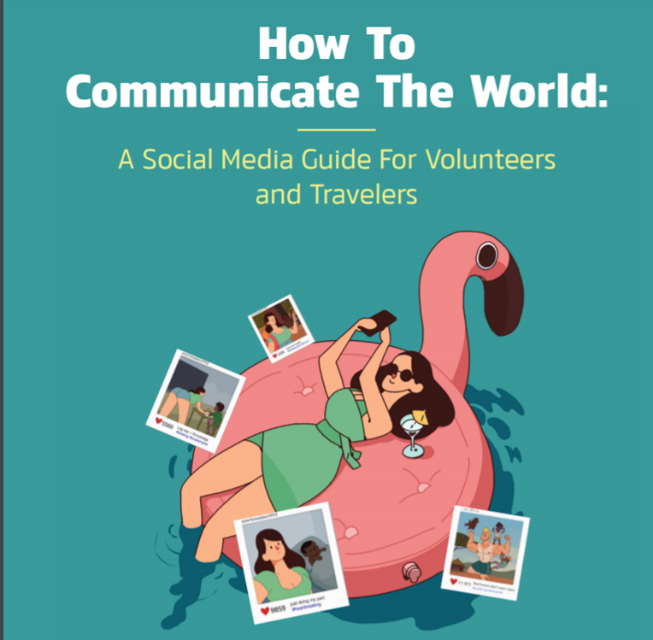

Slide 13
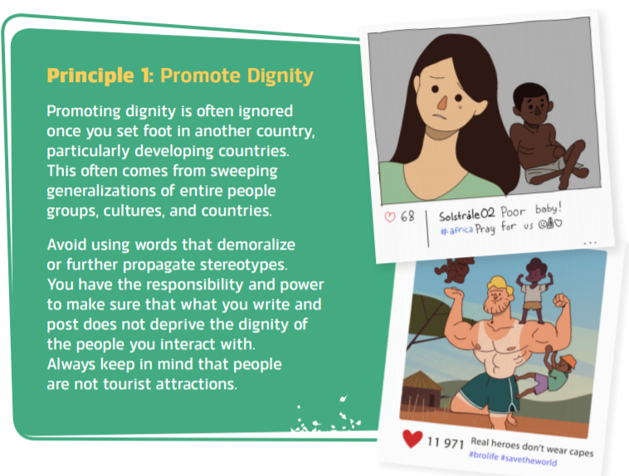

Slide 14
PAUSE - 3 minute discussion
Why is “promoting dignity” important when helping people from other countries?
Discuss with the person next to you and then feedback to the class.

Slide 16
PAUSE - 3 minute discussion
Why might “gaining consent” important when interacting with people from other countries?
Discuss with the person next to you and then feedback to the class.

Slide 17
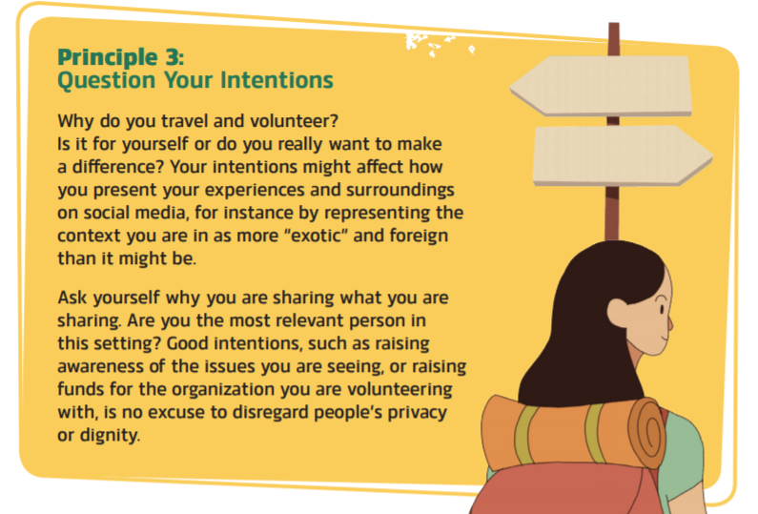

Slide 18
PAUSE - 3 minute discussion
Why is it important to understand your intentions and motivations before helping people from other countries?
Discuss with the person next to you and then feedback to the class.

Slide 20
PAUSE - 3 minute discussion
Why is it important to challenge stereotypes (and avoid perpetuating them) when helping people from other countries?
Discuss with the person next to you and then feedback to the class.

Slide 21
I N T R O D U C I N G T H E V O L U N T O U R I S T
2 5 M I N U T E S +

Slide 22
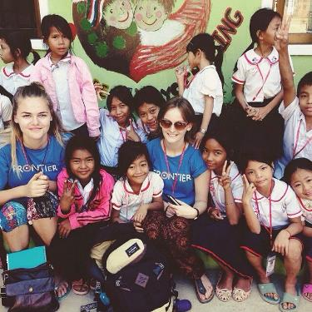
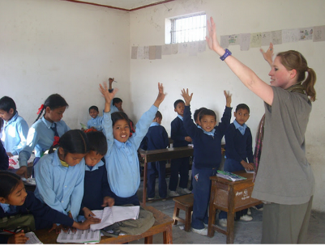
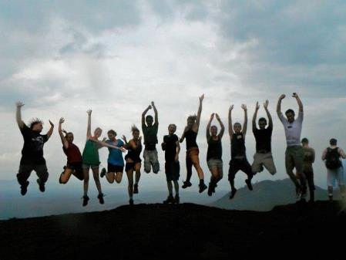
What is Voluntourism?
Share your responses…
Notes:
One way that young people can be encouraged to be involved with the wider world, is through volunteering tourism...

Slide 23
Voluntourism is…
“…traveling to a place to improve the economic well-being, socio-cultural development, or environmental conservation by providing volunteer assistance and/or goods and services.”
More simply put, Voluntourism is a form of tourism in which travellers participate in voluntary work (typically for a charity) during their travels.

Slide 24
Why do people volunteer overseas? What are some of the reasons as to why this is an appealing and popular thing to do?
Working in pairs or small groups, make a list of all of the reasons you can think of for why this has become such a popular thing for people to do.
Share your ideas with the class.
Now look at the list of reasons on the next slide – are there any that you didn’t think of?

Slide 25
It feels good. Altruism is a positive state – you give and you get back; and that feels good all around.
Volunteers benefit from a greater sense of social responsibility when they can improve the well-being of others
It gives participants an opportunity to interact with a different culture and to learn and explore new, broader perspectives of the world; deepening their understanding of humanity.
It introduces a new kind of philanthropy and a method for donating time and materials in a personal, meaningful way.
It meets travellers' growing desire to feel a sense of purpose whilst also pursuing leisure activities (which is why it has become so popular for gap years).

Slide 26
Who is doing it?
There are several million people volunteering internationally each year, with numbers growing rapidly over the past few years. Africa is the most popular continent for people to go to volunteer, closely followed by South Asia, whilst India and the Philippines are currently the most popular countries.
There are over 2000 registered volunteer organisations across the world offering a range of packages to suit your wishes. Voluntourism is now a billion dollar industry.
You may have heard of some of the following organisations:

Slide 28
Why is this industry both hugely positive and hugely negative?

Slide 29
There are many positive ripple effects that come from Voluntourism; many of which have been mentioned already and most of which you probably already know (or can think of).
However…
there are also many negative ripple effects happening across the world from this booming industry; many of which are only just starting to be talked about...

Slide 30
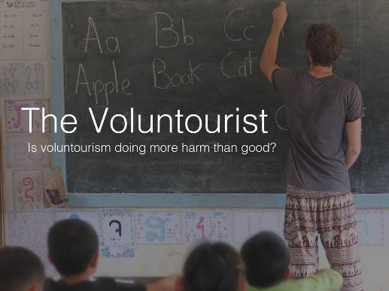
Watch a short extract (7.26 mins) taken from the full length documentary The Voluntourist made by Chloe Sanguinetti entitled:
The Volunteer’s Journey
Click on the link above for the film)

Slide 31
Allow students a few moments to respond to the film with the people sitting next to them.
Then as a group discuss initial responses and ideas related to the following questions:

Slide 32
Was there anything surprising in the film? What and why?
Were there any familiar scenes in the film?
If so, where have you seen examples of this happening before?

Slide 33
Voluntourism is now a multi-million pound industry, attracting more and more people every year. But who is Voluntourism benefiting the most?
The middle-man? (the person who organises the placement)
The local community?
The volunteer?

Slide 34
Talk about each person and think about how they might benefit from Voluntourism and also how (if at all) it might negatively impact them.
The middle-man? (the person who organises the placement)
The volunteer?
The local community?

Slide 35
H O W H E L P F U L I S
O U R H E L P ?
1 0 M I N U T E S +

Slide 36
Read the following article from World Travel Guide entitled:
Does Voluntourism do more harm than good?
(click on the link or click to the next slide to read)
The article explores some of the controversies around overseas volunteering and contains an interview with Mark Watson from Tourism Concern, who is a member of the BETTER VOLUNTEERING, BETTER CARE network.
ThoughtBox is also a member of this network and is working to share vital information, research and guidance about the dangers of volunteering overseas.

Slide 37
Does voluntourism do more harm than good? Volunteer holidays might seem virtuous, but they can create more problems than they solve. Should you volunteer abroad? Jack Palfrey - World Travel Guide
Dream of Tanzania and you probably envision climbing Mount Kilimanjaro or snapping the Big 5 in the Serengeti, but the East African country remains one of the poorest in the world.
A third of the population lives beneath the poverty line and there are issues with unsustainable agriculture, air pollution and a shortage of teachers. Many people are on the ground working to support change from within, but there are also people willing to help who don’t live there.

Slide 38
“I spoke to one girl who went to Tanzania to build a school. She told me the volunteers always gossiped about how lazy the locals were because they slept for most of the morning. It was only at the end of the placement that they discovered that every day, after they finished building a wall, the locals had to come and rebuild it again properly. So the whole thing was a completely pointless exercise.”
says Mark Watson, the Executive Director of Tourism Concern, a charity campaigning on ethical tourism issues.

Slide 39
PAUSE! … for a two minute discussion…
What is your response to this revelation, that locals were having to re-do work that volunteers were doing? Why might this be happening?

Slide 40
30 years ago, the only volunteering opportunities in places like Africa and Southeast Asia were for skilled medical professionals, who would take a year out from their work to ply their trade in a developing nation.
Fast-forward to 2015 and ‘voluntourism’, the modern-day equivalent of volunteering abroad, is a lot less exclusive.
Popularised by being included in gap-year agendas and seen as something positive to put on your CV, volunteering has become a trendy way for wealthy westerners to give back to less fortunate communities.
But despite good intentions from participants, volunteering abroad has attracted substantial criticism over the past few years.

Slide 41
"It's imperialistic in some ways – white people going out to Africa to help Africans."
“All too often, the volunteers do not know where they are going to be working before they arrive. How can that be effective?”

Slide 42
PAUSE! … for a two minute discussion…
Do you agree with these criticisms? What are some of the problems that you are learning about?

Slide 43
“Are the volunteers actually providing any benefits to the destination countries?” asks Watson. More often than not, the answer is unquestionably no.
The demand for volunteer spots in developing countries has led to hundreds of commercial volunteering organisations springing up. Many claim to have noble intentions but pocket the money for profit and send volunteers on unsatisfying, purpose-built placements.
Rather than benefiting local communities, voluntourism can have negative impacts, a number of studies have highlighted.

Slide 44
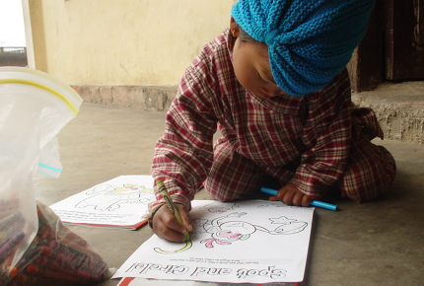
These range from volunteers taking local jobs to child trafficking, where young children are stolen from their families and placed into ‘orphanages’ to fuel the demand for volunteer placements. These kidnapped children are then subjected to deliberately poor living conditions to elicit higher donations from visiting westerners.
Nepal is one of the countries worst affected by orphanage tourism Creative Commons / Mark Emmerson

Slide 45
PAUSE! … for a two minute discussion…
Why do you think these issues are not talked about or known about very often?

Slide 46
While Watson acknowledges there are companies out there who employ good practice, it's a change in the mind-set of would-be volunteers he'd most like to see.
“I talk to a lot of people who say they want to dig wells in Africa,” says Watson. “I say what Africa has got quite a lot of is unskilled labour; there are a lot of people out there that can dig wells.
“The idea that you, as an unskilled worker, have got anything really useful that you can add is slightly arrogant and sort of imperialistic in some ways – white people going out to Africa to help the Africans.”

Slide 47
So does this mean Watson would like to see an end to volunteer placements abroad?
“I think it’s mostly about getting people to be realistic; you’re just doing it for yourself, it’s a holiday. You’re not really going to do anything particularly worthwhile, and that’s quite a hard message to get across.”

Slide 48
PAUSE! … for a two minute discussion…
Does this imply that volunteering overseas is often more selfish than selfless? What do you think? Is this a bad thing?

Slide 49
Kate Stefanko, Placement Director at People and Places, agrees, to an extent, but she thinks volunteering abroad can be beneficial to all concerned if it is done right.
“We believe that a carefully placed, thoroughly screened, well-prepared, skilled volunteer can – and does – have a positive impact,” says Stefanko.
All volunteers through People and Places have to apply for a position. Then, if accepted, the volunteer is matched with an upcoming project that can benefit from their skill set.

Slide 50
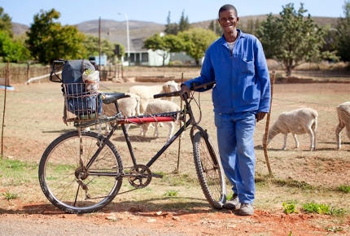
“Well-run efforts can absolutely develop a level of social interaction and understanding that is profound,” Stefanko adds. “The whole process can give a real face to poverty and vulnerability, and shift consciousness toward the understanding of a shared humanity.”
Past projects that Stefanko deems successful include a bicycle maintenance scheme in South Africa, which resulted in jobs for five youths and working bicycles for a remote area, and a volunteer with business experience who helped develop a community-based tourism product which increased income to poorer neighbourhoods.
Volunteers taught bicycle maintenance workshops in SA Creative Commons / Bicycle Portraits

Slide 51
Sceptics argue that volunteers would be better off donating money to ethical projects so local people can be employed to carry out the work. While Stefanko disagrees, she does believe there is some truth to it.
“Volunteers should ask themselves the question, ‘would I be allowed to do this work in my own country?’” she says. “If the answer is ‘no’, then we would agree.”
"Be wary of advertisements that use a ‘save the world’ message."
Does this include volunteering with children?
“We believe that only volunteers with real childcare or education skills should work on such projects,” says Stefanko.

Slide 52
PAUSE! … for a two minute discussion…
Why might it important to ask the question, “Would I be allowed to do this work in my own country?” before taking up a volunteer position overseas?

Slide 53
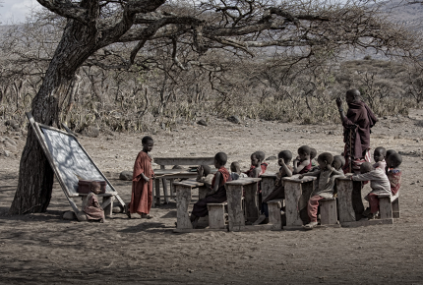
“That said, we have placed volunteers who are still training in their own country – but only if we have matched them with another volunteer who is highly skilled.”
The exponential size of the industry has made auditing almost impossible, and volunteers can have very different experiences depending on the organisation they book with. These can range from fulfilling and meaningful, to pointless and potentially damaging.
Untrained volunteers working with children is an issue for many Creative Commons / Feans

Slide 54
So how do volunteers with good intentions avoid the pitfalls of the industry?
Claire Bennett works as part of the Learning Service, an organisation that readies volunteers for placements abroad.
“There are certainly some red flags to look out for in the marketing of volunteer placements,” Bennett says. “Be wary of advertisements that make it seem easy or heroic to be a volunteer, that use a ‘save the world’ message. Also watch out for touristic overtones that seem to be catering to the needs and choices of the ‘client’.
“Instead, look for organisations that seem to be transparent and honest, those that are open to answering questions,” she adds. “Or those that convincingly measure impact as change, rather than just numbers of things built or given away.”

Slide 55
Like a blood-sucking tick, the superficial voluntourism industry has latched on to the good name of volunteering and spent a decade poisoning its host.
Before further harm is done, a clear conceptual divide needs to be drawn between the ill-planned, short-term volunteering projects and the meaningful, long-term projects that resemble the initial practice embarked upon by medical professionals in the past.
Research is key when it comes to choosing a project that falls under the latter category, also helping volunteers to prepare more thoroughly and manage expectations.
Down with voluntourism, up with volunteering.

Slide 56
PAUSE! … for a two minute discussion…
What are some of the main messages that you have learned in this article?
Why are they hard to hear, or unpopular ideas do you think?

Slide 57
U N D E R S T A N D I N G
O U R C A P A C I T I E S
2 0 M I N U T E S +

Slide 58
Traveller and lecturer Daniella Papi coined the phrase “The Clark Kent Effect” to explore some of the unspoken behaviour that surrounds volunteering:

Slide 59
Click on the link to listen to this short (15min) podcast from the BBC interviewing Daniela entitled:
The Problem with Volunteering
AND/OR
Take a look at her short (10.17mins) TEDx talk entitled:
What’s wrong with Volunteer travel?
(Click on the hyperlink)

Slide 60
She explains the idea as follows:
“In their every day lives, most students and young people do not have the skills, training or experience to be working as professional teachers, builders, farmers, primary care-givers, councillors, painters, decorators, medical practitioners etc.
HOWEVER…
The unspoken premise is that, when you don your volunteer t-shirt, you can all be whatever you want to be; you can do anything and you suddenly have all of the power and knowledge you need to save the world!”
From Clark Kent to Superman…

Slide 61
Why are these issues happening do you think?

Slide 62
As part of her exploration of “The Clark Kent effect”, Papi talks about the need to understand the dangers that come with this unspoken form of “disguised expertise” and some of the unfair responsibilities that volunteer-tour organisations are putting onto both students and local communities.
She uses the example of taking on Work Experience or an Internship compared to an overseas volunteer project to explore our responses to service and where/how Voluntourism is getting it wrong.
Clark Kent –
a dangerous hero?

Slide 63
When you go somewhere for work experience or an internship, the common expectation is:
You are there primarily to learn
You expect to be doing a lot of smaller jobs or help others with tasks
You expect to be managed
You are part of a larger organisation and work with skilled people within the organisation
You are working for a bigger cause than yourself
You do not expect to be telling people in the organisation what to do our how to do their job
You are there simply to serve and to learn

Slide 64
However, for some reason, none of this same reasoning seems to apply when taking up a volunteer placement.
Papi explores some of the differences in more detail:

Slide 65
1. You are there to primarily to learn
For some reason, the expectation of volunteering is to “do” rather than learn, or to “show” rather than observe.
2. You expect to be doing a lot of smaller jobs or help others with tasks
The expectation of many volunteers is to do big things quickly, and to take charge; often of jobs that require high levels of skill and training
3. You expect to be managed
The premise of many volunteer roles is that outsiders come into a community and take charge
4. You are part of a larger organisation and work with skilled people within the organisation
Often, volunteers are working just with other volunteers; bypassing the skills of locals or choosing to not talk with them and learn from them

Slide 66
5. You are working for a bigger cause than yourself
For many volunteers, the underlying premise is to do something or to complete something that you can then show other people back home what you have achieved
6. You do not expect to be telling people in the organisation what to do our how to do their job
Unfortunately, unskilled volunteers are often showing or telling local workers how to do things, giving them orders or ignoring them completely
7. You are there simply to serve and to learn
Unfortunately, the premise of learning and taking, rather than “giving” Is not part of the volunteer narrative.

Slide 67
Although the premise and intention behind Voluntourism is a very positive thing, the impact and the actual approach can often be negative if not enough research and planning is carried out beforehand.
This is why it is important to really think about and research any project before you sign up.

Slide 68
Is the project sustainable?
Is the project working in collaboration/ harmony with the local community?
Find out:
Do I have the skills required for this placement?
Am I being encouraged to research local customs, language and traditions before I arrive?
Is there a long-term goal to achieve using short-term voluntary aid?
Where is my money going? (if it is a paid placement)
Will I be putting someone out of a job if I take this placement?

Slide 69
Now think about the following question:
Are good intentions good enough when it comes to volunteering overseas?

Slide 70
VOLUNTOURISM
T H I S S O R T O F L E A R N I N G
C A N ’ T W A I T

