Slide 1
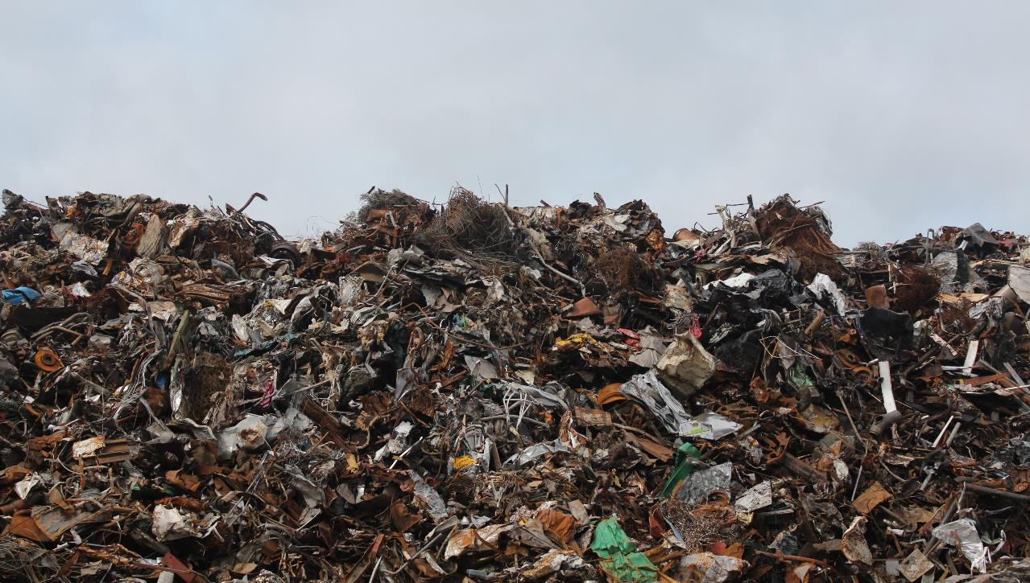
W A S T E
E N V I R O N M E N T A L E N G A G E M E N T
Y9&10
13-15 years

Slide 2
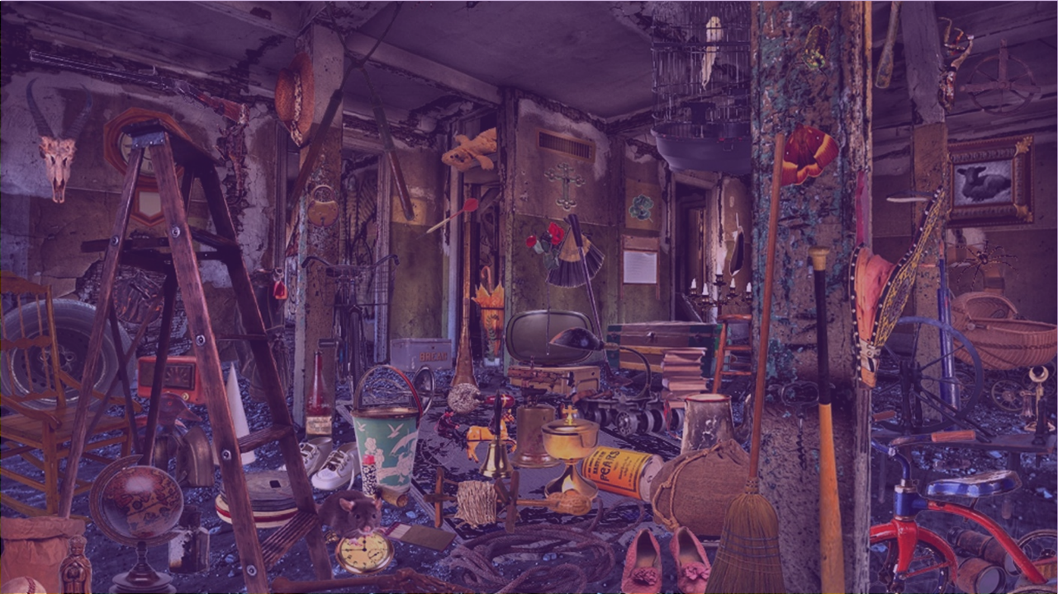
W H E R E S H A L L W E P U T A L L T H I S S T U F F ?
W E E K 2
1 HOUR

Slide 3
In this lesson, students will:
THINK!
Think about and discuss how and why we are creating so much waste
Understand how the impact of our waste is felt by people and places we never think about
Explore and unravel some of the untold ripple effects of consumption and waste production
FEEL!
UNLEARN!

Slide 4
P R E – L E S S O N
R E F L E C T I O N S
3 M I N U T E S +

Slide 5
Introduce the following REFLECTIVE QUESTIONS for students to consider during the lesson:
What happens to your “stuff” when you throw it away? Where does it go and what does it become?
How much unnecessary “stuff” do you think you have? Why?
Why do you think so many of us buy things that we do not actually need?

Slide 6
T H E S T O R Y O F
S T U F F
2 5 M I N U T E S +

Slide 7
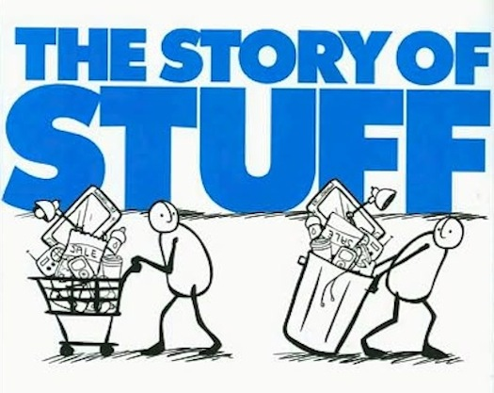
Watch the documentary (21 mins) made by Story of Stuff Project entitled:
The Story of Stuff
Click on the link above for the hyperlink

Slide 8
Allow students a few minutes to respond to the film with people sitting near to them.
After sharing their initial responses, ask them to consider the following questions:

Slide 9
What is the film trying to say about our wastefulness?
What is the film trying to explain about why we buy so much stuff that we don’t actually need?
Do you agree with these ideas?

Slide 10
T H E W A S T E Q U I Z
2 5 M I N U T E S +

Slide 11
“How much rubbish do you know?!”
Split the class into small groups of 3-5 people.
Hand out a piece of scrap paper and ask teams to number from 1-10 on their page.
The following quiz is a multiple-choice quiz, so all they need to write down is the letter corresponding to their answer.

Slide 12
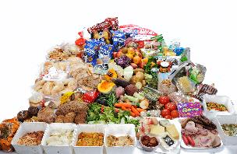
1. Approximately how much food produced across the world each year gets thrown away, rejected or wasted?
One third
One half
One quarter
One eighth

Slide 13
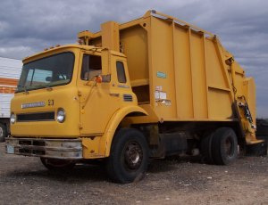
2. Every year we dump a massive 2.12 billion tons of waste. If all this waste was put into rubbish trucks lined up back to back, how many times would they wrap around the world?
4
17
24
28

Slide 14
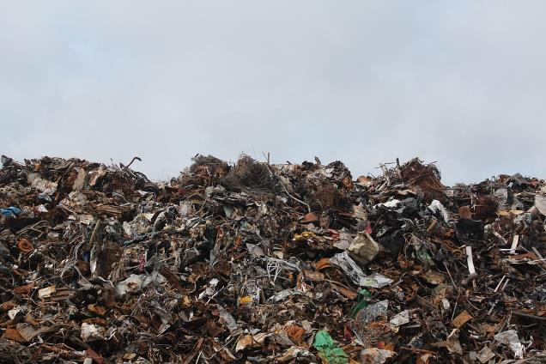
3. 99 percent of the stuff we buy is thrown away within how long?
6 months
2 years
8 years
17 years

Slide 15
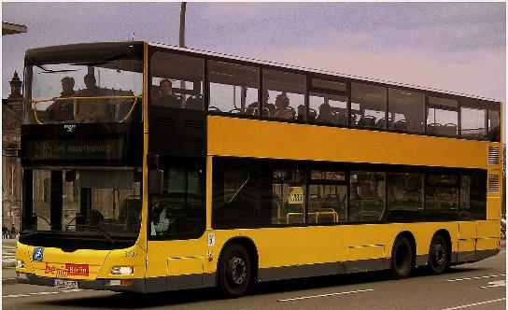
4. How many double decker buses could be filled with the electronic waste produced across the world each year?
100,000
500,000
1 million
4 million (50 mil tonnes)

Slide 16
5. What percentage of fruit and vegetables are rejected by supermarkets because they don’t “look right”?
5%
15%
25%
30%

Slide 17
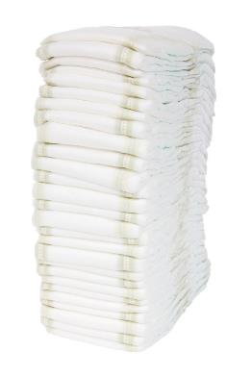
6. The number of disposable nappies an average baby gets through in their childhood weighs the same as what?
A bicycle
An average adult
A horse
A small car

Slide 18
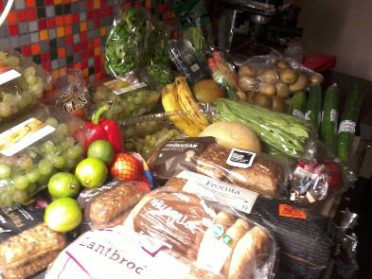
7. What percentage of greenhouse gas emissions from western countries comes from growing food that is never eaten?
10%
15%
20%
45%

Slide 19
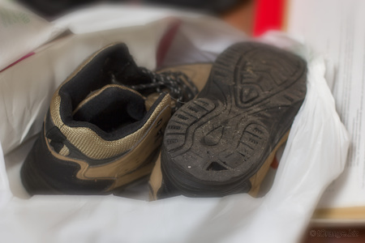
8. Extending clothing life by just 3 months can reduce carbon, water and waste footprints by up to how much?
1%
5%
10%
20%

Slide 20
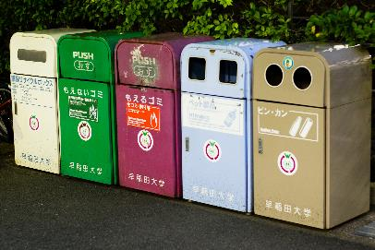
9. Japan and America have similar levels of GDP per capita but how much less rubbish does the average Japanese person produce?
One half less
One third less
One quarter less
One fifth less

Slide 21
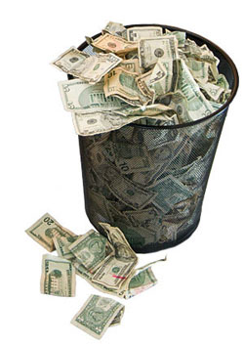
10. Americans throw out the equivalent of how much in wasted food every year?
$875 million (£511 million)
$45 billion (£26.2 billion)
$70 billion (£40.8 billion)
$165 billion (£96.3 billion)

Slide 22
The Answers!

Slide 23
1. Approximately how much of the food produced globally for human consumption gets thrown away, rejected or wasted?
One third
One half
One quarter
One eighth

Slide 24
2. Every year we dump a massive 2.12 billion tons of waste. If all this waste was put into rubbish trucks lined up back to back, how many times would they wrap around the world?
4
17
24
28

Slide 25
3. 99 percent of the stuff we buy is thrown away within how long?
6 months
2 years
8 years
17 years

Slide 26
4. How many double decker buses could be filled with the electronic waste produced across the world each year?
100,000
500,000
1 million
4 million (50 million tonnes)

Slide 27
5. What percentage of fruit and vegetables are rejected by supermarkets because they don’t “look right”?
5%
15%
30%
50%

Slide 28
6. The number of disposable nappies an average baby gets through in their childhood weighs the same as what?
A bicycle
An average adult
A horse
A small car

Slide 29
7. What percentage of greenhouse gas emissions from the West come from growing food that is never eaten?
10%
15%
20%
45%

Slide 30
8. Extending clothing life by just 3 months can reduce carbon, water and waste footprints by up to how much?
1%
5%
10%
20%

Slide 31
9. Japan and America have similar levels of GDP per capita but how much less rubbish does the average Japanese person produce?
One half less
One third less
One quarter less
One fifth less

Slide 32
10. Americans throw out the equivalent of how much in wasted food every year?
$875 million (£511 million)
$45 billion (£26.2 billion)
$70 billion (£40.8 billion)
$165 billion (£96.3 billion)

Slide 33
Ask students to discuss their responses to some of the statistics raised in the quiz. In particular think about:
Any surprising or shocking statistics that they were not aware of
Any thoughts they have on how to combat some of the problems and issues raised
Any thoughts they may have about the current waste levels across the world

Slide 34
What could some of the solutions to our waste problems be?
Recycle more?
Waste less?
Consume less?
Think more?

Slide 35
L E T ‘ S G O
S H O P P I N G (A G A I N)
5 M I N U T E S +

Slide 36
Remind students of the two terms used in the documentary and see if they can remember what they mean:
Planned Obsolescence
Perceived Obsolescence

Slide 37
Planned Obsolescence is…
Designing and producing products in order for them to be used up (obsolete) within a specific time period. Products may be designed for obsolescence either through function, like a paper coffee cup or a machine with breakable parts, or through “desirability,” like a piece of clothing made for this year’s fashion and then replaced by something totally different next year. Planned obsolescence is also known as “designed for the dump.”

Slide 38
Perceived Obsolescence is…
The part of planned obsolescence that refers to “desirability”. In other words, an object may continue to be functional, but it is no longer perceived to be stylish or appropriate, so it is rendered useless by perception, rather than by function. Fashion is all about perceived obsolescence, and this trick is often seen as the number one “product” of the advertising industry as they manipulate our perceptions to “trick us” into buying more and more stuff.

Slide 39
Had you heard of these terms before?
Were you aware that these things were happening?
How do you feel about advertising encouraging you to think you “need”
stuff that you don’t?

Slide 40
T O O M U C H S T U F F
5 M I N U T E S +

Slide 41
Read this article exploring our obsession with consuming and wasting excessive amounts of “stuff”.
After reading, ask students to discuss their thoughts on some of the points raised, and ways in which we all, as individuals, have responsibilities when it comes to reducing our waste.
(A copy of the article is also available on the following slides:)

Slide 42
The hazards of too much stuff
BBC News Magazine | by James Wallman
We have more stuff than we could ever need - kit we don't use, toys we don't play with, and clothes we don't wear.
Consider the average British woman. According to various surveys, she buys 59 items of clothing each year, she has twice as many things in her wardrobe today as she did in 1980, and she has 22 things in there she has never worn.
I’m not piling all the blame on to the average British woman though. We're all guilty. So many of us have so much stuff today, in fact, that a team of anthropologists at the University of California, Los Angeles (UCLA) have decided, after one of the most extensive pieces of research into contemporary life ever conducted, that we are living in "the most materially rich society in global history, with light-years more possessions per average family than any preceding society".

Slide 43
In the smallest home in their study, a house of 980 sq ft, there were, in the two bedrooms and living room alone, 2,260 items. And, because of the rules the anthropologists were using to count, that was only the things they could see when they stood still. They didn't count any of the stuff that was tucked into drawers or squeezed into cupboards.
The other homes were just as packed. On average, each family had 39 pairs of shoes, 90 DVDs or videos, 139 toys, 212 CDs and 438 books and magazines. Nine out of 10 had so many things that they kept household stuff in the garage. Three quarters of them had so much stuff in there, there was no room left for cars.
All the case studies were in the US. But is it really that much different in the UK or any other Western country? Do you have lots of stuff? Do you have more than you need or use? Do the kids have too many toys? How many pairs of shoes, DVDs, and books and magazines do you have? Is there room for cars in the garage?

Slide 44
As you can see, this is clearly not only an American problem, or a British problem. We're all to blame, and we're all suffering. At the end of their study, the anthropologists concluded that because of the sheer numbers of artefacts people today own, we are at a point of "material saturation". We are coping with "extraordinary clutter" - facing a "clutter crisis".
The simplest way to explain not only why we are drowning in stuff, but also why this is happening now, is through a relatively new branch of the social sciences called evolutionary psychology.
This discipline tries to explain why we do what we do - based on how we've adapted and evolved over billions of years. It makes sense, for instance, of why we like sweet, fatty foods like cake, and why we eat as much as we do. Food scientist Brian Wansink, author of Mindless Eating, wrote: "We have millions of years of evolution and instinct telling us to eat as often as we can and as much as we can."

Slide 45
This instinct to eat as much as possible whenever possible made sense when food was scarce. But it made a lot less sense when, in the 20th Century, synthetic fertilisers and higher-yielding seeds and combine harvesters produced not only enough, but much more than enough.
Now, although the automatic impulse to eat as much as possible was no longer relevant, we weren't able to simply switch it off like a light switch. Hardwired to eat, many of us became fat. Now we talk of an obesity epidemic.
Just as evolutionary psychology explains why we eat far more than we need, it also throws light on why we keep buying more, even when we already have far more than enough.

Slide 46
We are now living in an age of abundance in the West. Before, material goods were expensive and scarce. Clothes were so hard to come by that they were handed down from generation to generation. A historian called Eve Fisher has calculated that before 1750 and the onset of the industrial revolution a shirt would have cost around £2,000 in today's money. But now, things - shirts, shoes, toys and a million other consumer items - are cheap.
Once again, our inbuilt impulses have yet to catch up. As a result, many millions of us are filling our homes and lives, and suffocating under too much stuff.
This problem, which I call "stuffocation", is the material version of the obesity epidemic. Since obesity is one of the most worrying problems we face, as individuals and as a society, saying that stuffocation is similar is quite a statement.

Slide 47
But the comparison works, because both obesity and stuffocation have similar numbers of sufferers. About two-thirds of people are overweight, according to the UK government. But it's also been estimated about two in every three wish they had less stuff.
Both obesity and stuffocation are bad for your health. Just as eating too much and being overweight is lousy for your physical health, so having too much stuff and feeling "stuffocated" is damaging for your mental health.
Two psychologists who worked alongside the anthropologists at UCLA recorded how people feel about their homes and tested them for the stress hormone cortisol.
They found that women who have issues with clutter have the signature pattern of cortisol that is associated with people who have chronic fatigue, post-traumatic stress disorder, and a higher risk of mortality.

Slide 48
So what will save us from drowning in a suffocating sea of stuff? Lots of people have come up with solutions in recent years. There are the anti-capitalist and anti-consumerist movements, for instance. But none of them strike me as realistic alternatives. They all seem too simplistic to me.
If we rush into some sort of smash-the-system solution, we might end up throwing out the proverbial baby with the bathwater. Don't we want to keep all the good stuff that our system has brought us, like central heating, indoor plumbing, the internet, and smartphones? If so, we need a solution that won't bring the walls of our society tumbling down.

Slide 49
There might be an answer. This idea is inspired by some research that proves happiness is more likely to come from experiences rather than stuff. It's also inspired by Jamie Oliver's Food Revolution, a campaign aimed at changing school meals. But instead of helping people be healthier by nudging them to eat healthy instead of unhealthy food, as the Food Revolution does, this is an "experience revolution" that will help people be happier by nudging them to spend their time and money on experiences rather than stuff.
If more people do this, and join this "experience revolution", they will be happier - and they are far less likely to be drowning in stuff.

Slide 50
How responsible should we be as individuals for reducing our waste?

Slide 51
W A S T E
E N V I R O N M E N T A L E N G A G E M E N T
THIS SORT OF LEARNING CAN’T WAIT

