Slide 1
VOLUNTOURISM
SOCIAL PERSPECTIVES
Y9&10
13-15 years

Slide 2
M I N D T H E G A P
W E E K 3
3 0 M I N U T E S

Slide 3
In this lesson, students will:
THINK!
Think about some of the core motivations behind Voluntourism and some of the shifts we could make to align these more ethically
Understand some of the ripple effects of volunteering in orphanages and explore some of the stories being unearthed about the impact on people and communities.
Explore and unravel some of the ways that we are being encouraged to think about volunteering overseas and understand who and how the influences are working to stop us from looking under the surface
FEEL!
CONNECT!

Slide 4
P R E L E S S O N
R E F L E C T I O N S
3 – 5 M I N U T E S +

Slide 5
Introduce the following REFLECTIVE QUESTIONS for students to consider during the lesson:
Why is volunteering in an orphanage a popular thing for young people to do?
Can you think of any negative impacts of this sort of volunteering?
What does it mean to be an ethical volunteer?

Slide 6
B E H I N D T H E S C E N E S
3 0 M I N U T E S +

Slide 7
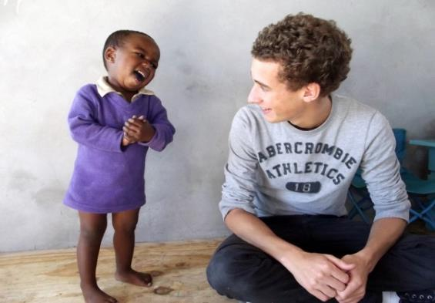
Watch the short film (4.02mins) put together by ThoughtBox entitled:
The Tourist and the Orphanage
(Click on the link above for the hyperlink)
Picture courtesy of www.projects-abroad.org

Slide 8
Allow students a few minutes to respond to the film with people sitting near to them.
After sharing their initial responses, ask them to consider the following questions:
Picture courtesy of www.projects-abroad.org

Slide 9
Were you shocked or surprised by any of the ideas raised in the film? If so which ideas and why?

Slide 10
There were four areas mentioned in the film which can create negative effects within the “Voluntourism” industry:
Gift Giving and the promotion of White Saviours
Teaching and Employment
False role models and increased abandonment
Increased demand for orphanages

Slide 11
Split the class into small groups and give each group one of these four issues.
Ask them to talk about what the CAUSE and EFFECT of this issue might be.
The cause would be the reason that this might be happening, and the effect would be the consequences of this happening.
For example:

Slide 12
1. Gift Giving and the promotion of White Saviours
What is the cause of this issue?
CAUSE: People often bring gifts and donations to orphanages because there is sometimes a lack of these same resources in communities

Slide 13
1. Gift Giving and the promotion of White Saviours
EFFECT: These gifts do not offer a sustained supply of resources, and increase the expectation of a reliance upon aid with the potential to fuel a dependence on western donations and support for empowerment.
What is the effect of this issue?

Slide 14
Now look at the following presentation called ‘The Volunteer and the Orphanage which gives more detailed information on some of the negatives that are coming out of this industry.

Slide 15
GIFT GIVING AND THE PROMOTION OF WHITE SAVIOURS
Bringing gifts of sweets, toys, games, clothes, stationery for school, shoes, colouring pens, books and temporary playmates is a common part of a volunteer’s luggage, and unsurprisingly these treats are always welcomed by children on the other side of the world. Being greeted with presents and having constant entertainment through the continuous flow of volunteers into orphanages seems like nothing but fun and on the surface is a very positive ideal.
However, the act of giving and receiving is what children associate the most with volunteers, and the ripple effect of this is a significant development of expectation amongst children, or a fundamental reliance upon handouts

Slide 16
“Give me money” is a common phrase heard in many parts of East Africa where voluntourists abound, whilst “Give me pencils/sweets/gifts” are regular phrases spoken by children across Nepal, Cambodia, Uganda, India and other countries where the sight of a westerner sparks an immediate reaction by children of “giving”.
Sadly, this relationship of “give and take” reflects the widening gap between the comparatively wealthy “help-givers” and the “needy” beneficiaries; reinforcing a story of “whites in shining armour” and a reliance on aid or handouts. The act also serves to produce stereotypical, overly positive images of the Western world in children’s minds, which ultimately widens the gap between the people within the community and the world of the volunteer.

Slide 17
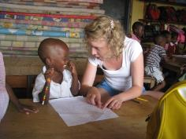
2. TEACHING AND EMPLOYMENT
Many volunteer organisations are offering tourists the opportunity to “teach” children; usually teaching English or classes of some sort. Although this may seem like a wonderful concept, and often appears to be filling a gap where there would normally be no teacher, the actual repercussions of this can have very detrimental effects on both the children and the wider community.
Firstly, teaching is a profession, no matter which country it is happening within. Every country housing formal schools has trained professionals who go to college, learn skills and have certified expertise in teaching. The majority of volunteers who are teaching do not have this; their only qualification being that they are able to speak English.

Slide 18
By replacing a skilled professional with an unskilled worker, this not only devalues the worth of the role (and the worth of all of the trained teachers and professionals in-country) but it also devalues the education that the children are receiving. Because of the short term nature of most volunteer teachers, children are going from one person to the next; changing teachings styles and content and often learning the same thing over and over, with no “end goal” or sustainable teaching plan put into place. It is somewhat rare for a volunteer to have knowledge of a local education system, language and curriculum and thus the child is already missing out the fundamental basics of their education system, and instead a supposed idea of what the children should be learning is enforced.
The premise of an unskilled worker entering the role of teaching devalues the profession and also frequently puts someone out of a job. The reason that many orphanages and associated schools do not have teachers is because, rather than pay a trained professional to work in the role, volunteers are “paying” the owners to come and do the job; so to actually pay someone a wage seems (in retrospect) a false economy, thus creating a negative cycle for all involved.

Slide 19
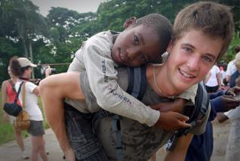
It is very rare for volunteer teachers to be vetted or to be required to possess skills. Think of this happening in your own county – a random, untrained adult being allowed to spend considerable amounts of time influencing and working with young vulnerable children…this simply would not happen and we would not condone it. Yet for some reason, it has been assumed that this is ok to do in other countries across the world; again enforcing a somewhat hypocritical approach to the relationship.

Slide 20
3. FALSE ROLE MODELS AND INCREASED ABANDONMENT
On the outside, the idea of young children housed within an orphanage, lacking in parents, affection and guidance may seem like a draw for kind hearted people to want to go and spread some love. However, the constant flux of volunteers can actually hinder the emotional development of children.
Building strong connections with mentors who will walk out of their lives a short time later is not, in the long term, a positive situation for any child; especially a child who may already be emotionally vulnerable. It is very rare for a volunteer to sustain a relationship of contact with a child or a community within an orphanage once the project is complete; and thus children are gaining and losing adult affection on a regular basis.

Slide 21
Although unintentional or perhaps just thought through on the behalf of the volunteer, this is another form of abandonment from what the child may have already experienced in their life, and can understandably have a very detrimental effect on their long term mental health and ability to form meaningful connections with others.
Many of the children living within orphanages perhaps lack adult role models in their daily lives, and it may seem as though the volunteer can fill this void. However, it could be argued that the majority of these children would benefit more from having a local role model as a starting point; someone whose life was understandable and achievable in the short term, rather than worshipping a wealthy foreigner whose life is far removed from their own, and whose aspirations live on a different plain of existence.
In many instances, volunteers are creating false role models for children that will never be achieved in their lifetimes.

Slide 22
4. INCREASED DEMAND FOR ORPHANAGES
Ironically (and tragically) one of the most negative impacts of volunteers within orphanages is that they create a demand for more orphans. In many countries, orphanages are run by both private and public companies; many of whose sole aim is to generate income. Thus, to be a success, the orphanage needs to be full and bringing in volunteers and their income.
We would objectively look at an orphanage being full of children as a very negative thing – too many children out of a family and a loving unit. However, for whatever reason, the popular orphanages with tourists are the full and busy ones; the ones filled with children, as these perhaps appear the children most in need. The irony is that, more often than not, these children have one or more parents alive (if not other family members) but have been lured into the orphanage under the false promise of a better life (an education, three meals a day, a more positive future etc.). The reality of their presence in the orphanage is, sadly, often to lure in more volunteers and their donations.

Slide 23
Most orphanages that accept volunteers do not screen the visitors and don’t really question what the intentions are to be close to children all day. This quite obviously opens the doorway to much abuse, with these same vulnerable children once again the ones who are suffering.
Often, owners of volunteers will entice families to send their children to the orphanage to get a “better life”, but it has been shown that volunteers most frequent orphanages that “look poor”, and thus it is in the interest of the owners to keep the place looking shabby, the children looking impoverished and the organisation looking in-need.
Visiting an orphanage or volunteering in an orphanage has somehow become a tourist attraction, with many travellers making this a planned part of their trip. Step back from this idea and think about it in the context of your own country: can you imagine a tourist coming to London, for example, and asking to see Big Ben, Westminster Abbey and a couple of orphanages? It is simply not something that would be tolerated; so why have we made this acceptable behaviour when we travel to other countries?

Slide 24
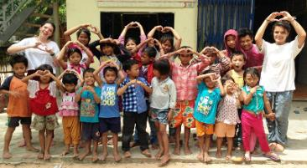
Although the intentions behind volunteers wanting to spend time in orphanages is positive, it is no longer good enough to have the intention as the only thought; it is important to really critically assess what is happening and whether the intentions (however positive) will lead to positive or negative ripple effects.

Slide 25
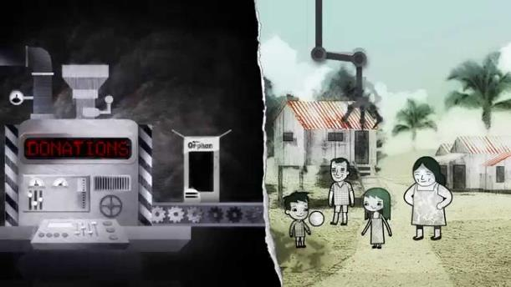
Watch the short cartoon (1.16 mins) made by Child Safe Movement entitled:
Don’t create more orphans
Click on the link above for the hyperlink

Slide 26
Allow students a few minutes to respond to the film with people sitting near to them.
After sharing their initial responses, ask them to consider the following questions:

Slide 27
“Your donations don’t help orphans, they create them”
What do you think this means?
Why do you think orphanage volunteering has become so popular for western travellers?

Slide 28
Many of the big volunteer opportunity organisations are now pulling out their projects from inside orphanages.
Take a look at the following article from ABC news entitled: Push to end volunteering in orphanages as World Challenge stops trips for students

Slide 29
Why is it so difficult to talk about some of the negative ripple effects of Voluntourism?
Discuss with the person next to you, and then have a general discussion in the class.

Slide 30
Think about some of the positive messages and action points that you can take if you are considering volunteering overseas.
Remember – the intention and the action can be as positive as you intend, you just need to make sure you do some research before you go – and ensure that the ethics of the project (and your intentions) are in the right place.

Slide 31
VOLUNTOURISM
T H I S S O R T O F L E A R N I N G
C A N ’ T W A I T

