Slide 1
SOCIAL MEDIA
CULTURAL IDENTITY
Y9&10
13-15 years

Slide 2
T O I N F I N I T Y A N D
B E Y O N D
W E E K 4
60 MINUTES

Slide 3
In this lesson, students will:
THINK!
Think about and discuss the role that technology plays in our daily lives
Understand how our use of technology is a choice and we need to become wise in our decision making
Explore and unravel the impact that technology is having on our lives in ways that we may not think about
FEEL!
UNLEARN!

Slide 4
P R E – L E S S O N
R E F L E C T I O N S
3 M I N U T E S +

Slide 5
Introduce the following REFLECTIVE QUESTIONS for students to consider during the lesson (maybe write them up or read them aloud and ask students to think about their own responses):
How reliant are we becoming on Social Media and is this a good thing?
Are we able to stay in control of the technology that we are using?
Can we learn to use Social Media in a way to bring about social change?

Slide 6
T A K E A L O O K
I N S I D E Y O U R B R A I N
1 0 M I N U T E S +

Slide 7
Watch the short film (3.53 mins) made by Ephipheo entitled:
What the internet is doing
to our brains
Click on the link above for the hyperlink

Slide 8
Allow students a few minutes to respond to the film with people sitting near to them.
After sharing their initial responses, ask them to consider the following questions:

Slide 9
Do you recognise any of your own behaviour here?
Are there thoughts or ideas in this film that you found inspiring, engaging or useful? Why
Are there thoughts or ideas in this film that you found inspiring useless or absurd? Why?

Slide 10
T H E P O W E R T O
C H A N G E T H E W O R L D
1 5 M I N U T E S +

Slide 11
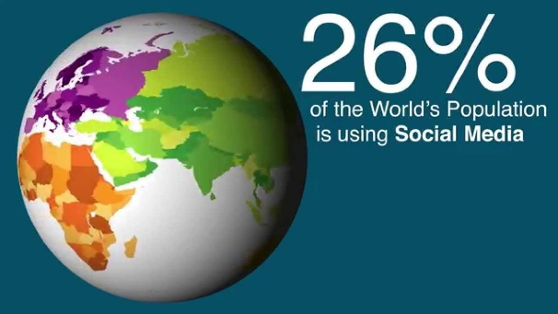
Watch the short video (3.36 mins) made by the School of International Development at the University of East Anglia entitled
Does Social Media have
the power to change
the world?
Click on the link above for the hyperlink

Slide 12
Allow students a few minutes to respond to the film with people sitting near to them.
After sharing their initial responses, ask them to consider the following questions:

Slide 13
Why do you think that Social Media has become so popular across the world?
Is the spread of Social Media a positive addition to our lives? Why?
What are some of the barriers that exist to using Social Media?

Slide 14
1. Refresh students with some of the ideas raised in the film and ask them to think about the positive and negative ripple effects that social media is causing across the world.
2. Now split the class up into small groups (around three or four students per group) and give each group one of the statements about the potential for social media to change the world
3. Ask them to note down ways in which this is positive addition to our societies.

Slide 15
Social Media can help to:
Create a digital global village!
Distribute vital information about health!
Increase opportunities for global education!
Allow people to report other people’s activities!
Influence the media through people’s opinions and blogs!
Connect people within interest groups!
Encourage cross-cultural conversations!
Mobilise people to come together and take action!

Slide 16
After thinking about and discussing the positives of this role, now ask students to think about some of the negatives or problems that this idea may bring to our societies.
Share thoughts with the class and discuss together.

Slide 17
D O W E R E A L L Y
N E E D T H I S ?
2 0 M I N U T E S +

Slide 18
“New things are always better things when it comes to technology."
Why are we sometimes encouraged to believe this statement?

Slide 19
Ask students to think about this idea and share their thoughts. Think about their reaction to new technologies and whether they always feel they are a positive addition to their lives.
Now split the class up into small groups, and give each group one of the four technological developments mentioned below and on the following slides:
1. One Laptop Per Child
2. Google Glass
3. Pebble Smartwatch
4. Siri
(Students may also wish to choose another new technology that they are aware of and discuss this)

Slide 20
If time (and resources) allow, give each group time to look up their product and find out a little bit about its described benefits. Then ask them to think about the positive and the negative impact this technology may have on people and the environment.
NB: this activity can also be done as a whole-class discussion
Ask students to feedback their learning and their ideas to the class and discuss collectively some of the positives and negatives of these technologies (referring back to the original statement.)

Slide 21
1. One Laptop Per Child
Click on the link to learn more about this technology:
http://one.laptop.org

Slide 22
How is this technology trying to help us?
What are some of the positives that it can offer to society?
What are some of the negatives that it could offer?

Slide 23
2. Google Glass
Click on the link to learn more about this technology:
https://www.google.com/glass/start/

Slide 24
How is this technology trying to help us?
What are some of the positives that it can offer to society?
What are some of the negatives that it could offer?

Slide 25
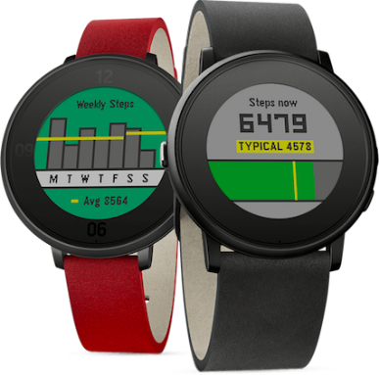
3. Pebble Smartwatch
Click on the link to learn more about this technology:
https://www.pebble.com

Slide 26
How is this technology trying to help us?
What are some of the positives that it can offer to society?
What are some of the negatives that it could offer?

Slide 27
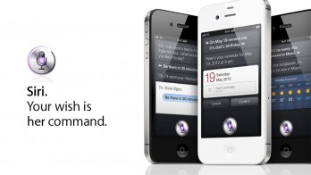
4. Siri
Click on the link to learn more about this technology:
http://www.apple.com/ios/siri

Slide 28
How is this technology trying to help us?
What are some of the positives that it can offer to society?
What are some of the negatives that it could offer?

Slide 29
THINKING OUTSIDE THE BOX
NB: It is often harder to think up the negatives to some of these technological revolutions, but try to consider some of the longer term ramifications as well as the impact on us as a social interactive creature.
This skill of critically assessing what we’re being sold is such a vital skill for us to practice.

Slide 30
Now come back to this statement and talk together about whether you agree with this or not and why.
“New things are always better things when it comes to technology."

Slide 31
T H E P A R A D O X O F
C H O I C E
1 0 M I N U T E S +

Slide 32
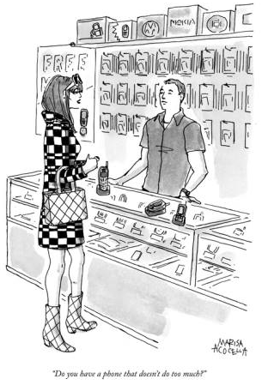
Take a look at this image and discuss some of the ideas it is raising.

Slide 33
Have you ever heard of the phrase
What do you think it might mean?
The Paradox of Choice

Slide 34
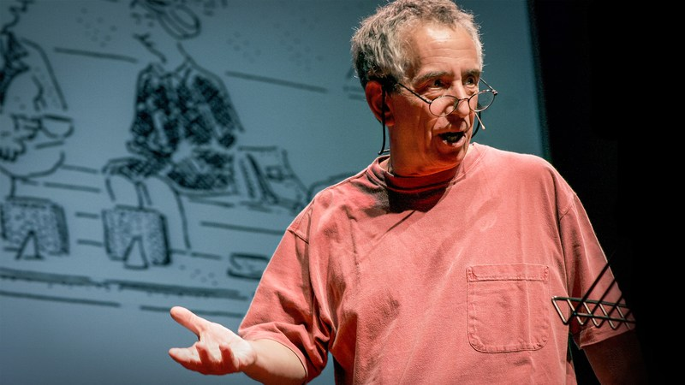
"The Paradox of Choice“ is a concept defined by psychologist Barry Schwartz.
…every day decisions – from the mundane to the profound – have become increasingly complex due to overwhelming abundance of choice with which we are presented. We assume that more choice means better options and greater satisfaction. But beware of choice overload: it can make you question the decisions you make before you even make them, it can set you up for unrealistically high expectations, and it can make you blame yourself for any and all failures.
He argues that

Slide 35
With so many possible choices, we risk not making a choice at all. Enter 'The Paradox of Choice’.
An abundance of choices leaves us unsatisfied with the choices we make, whilst FoMo can lead either to failure to make matches or failure to commit to the matches you’ve made…
This concept is becoming more and more apparent in our daily lives, in particular when it comes to technology.

Slide 36
Is endless choice a good or a bad thing?
How might it be affecting our ability to feel confident in the choices that we do make?

Slide 37
If time allows, watch the inspiring TED talk (19.37mins) from psychologist and author Barry Schwartz entitled:
The Paradox of Choice
Click on the link above to play the video.

Slide 38
S O C L O S E A N D Y E T
S O F A R
1 0 M I N U T E S +

Slide 39
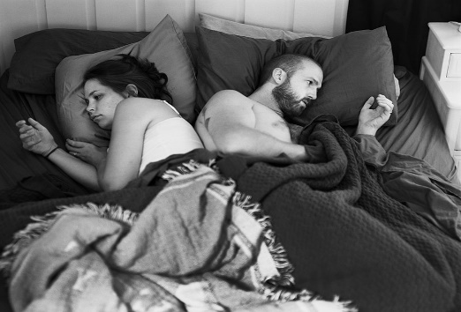
Watch this short video (3.09 mins) put together by ThoughtBox using images from photographer Eric Pickersgall entitled:
Removed
Click on the link above for the hyperlink

Slide 40
Allow students a few minutes to respond to the film with people sitting near to them.
After sharing their initial responses, ask them to consider the following questions:

Slide 41
What do these images make you think about?
What might the photographer Erik Pickersgall be trying to show with this project do you think?
Do think that we are becoming more or less connected through our use of social media? Why?

Slide 42
SOCIAL MEDIA
CULTURAL IDENTITY
THIS SORT OF LEARNING
CAN’T WAIT

