Slide 1
SOCIAL MEDIA
CULTURAL IDENTITY
Y9&10
13-15 years

Slide 2
T O I N F I N I T Y A N D
B E Y O N D
W E E K 4
60 MINUTES

Slide 3
In this lesson, students will:
THINK!
Think about and discuss the role that technology plays in our daily lives
Understand how our use of technology is a choice and we need to become wise in our decision making
Explore and unravel the impact that technology is having on our lives in ways that we may not think about
FEEL!
UNLEARN!

Slide 4
P R E – L E S S O N
R E F L E C T I O N S
3 M I N U T E S +

Slide 5
Introduce the following REFLECTIVE QUESTIONS for students to consider during the lesson (maybe write them up or read them aloud and ask students to think about their own responses):
How reliant are we becoming on Social Media and is this a good thing?
Are we able to stay in control of the technology that we are using?
Can we learn to use Social Media in a way to bring about social change?

Slide 6
T A K E A L O O K
I N S I D E Y O U R B R A I N
1 0 M I N U T E S +

Slide 7
Watch the short film (3.53 mins) made by Ephipheo entitled:
What the internet is doing
to our brains
Click on the link above for the hyperlink

Slide 8
Allow students a few minutes to respond to the film with people sitting near to them.
After sharing their initial responses, ask them to consider the following questions:

Slide 9
Do you recognise any of your own behaviour here?
Are there thoughts or ideas in this film that you found inspiring, engaging or useful? Why
Are there thoughts or ideas in this film that you found inspiring useless or absurd? Why?

Slide 10
T H E P O W E R T O
C H A N G E T H E W O R L D
1 0 M I N U T E S +

Slide 11
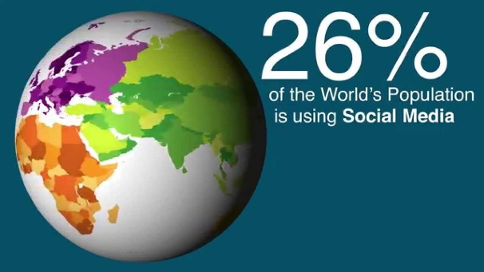
Watch the short video (3.36 mins) made by the School of International Development at the University of East Anglia entitled
Does Social Media have
the power to change
the world?
Click on the link above for the hyperlink

Slide 12
Allow students a few minutes to respond to the film with people sitting near to them.
After sharing their initial responses, ask them to consider the following questions:

Slide 13
Why do you think that Social Media has become so popular across the world?
Is the spread of Social Media a positive addition to our lives? Why?
What are some of the barriers that exist to using Social Media?

Slide 14
1. Refresh students with some of the ideas raised in the film and ask them to think about the positive and negative ripple effects that social media is causing across the world.
2. Now split the class up into small groups (around three or four students per group) and give each group one of the statements about the potential for social media to change the world
3. Ask them to note down ways in which this is positive addition to our societies.

Slide 15
Social Media can help to:
Create a digital global village!
Distribute vital information about health!
Increase opportunities for global education!
Allow people to report other people’s activities!
Influence the media through people’s opinions and blogs!
Connect people within interest groups!
Encourage cross-cultural conversations!
Mobilise people to come together and take action!

Slide 16
After thinking about and discussing the positives of this role, now ask students to think about some of the negatives or problems that this idea may bring to our societies.
Share thoughts with the class and discuss together.

Slide 17
S O C L O S E A N D Y E T
S O F A R
1 0 M I N U T E S +

Slide 18
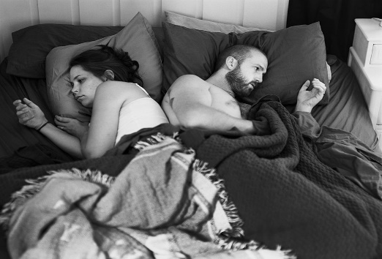
Watch this short video (3.09 mins) put together by ThoughtBox using images from photographer Eric Pickersgall entitled:
Removed
Click on the link above for the hyperlink

Slide 19
Allow students a few minutes to respond to the film with people sitting near to them.
After sharing their initial responses, ask them to consider the following questions:

Slide 20
What do these images make you think about?
What might the photographer Erik Pickersgall be trying to show with this project do you think?
Do think that we are becoming more or less connected through our use of social media? Why?

Slide 21
SOCIAL MEDIA
CULTURAL IDENTITY
THIS SORT OF LEARNING
CAN’T WAIT

