Slide 1
HOMELESSNESS
SOCIAL PERSPECTIVES
Y9&10
13-15 years

Slide 2
L I V I N G O N
T H E E D G E
W E E K 3
1 5 M I N U T E S

Slide 3
In this lesson, students will:
THINK!
Think about the notion of displacement and of human rights and what it means when being homeless becomes a crime
Understand some of the impacts of being removed from your home, country or identity through no choice, and losing rights to find a way out
Explore and unravel some of the ways that our identity is linked to our home and explore stories of people exploring new ideas surrounding homelessness
FEEL!
UNLEARN!

Slide 4
P R E L E S S O N
R E F L E C T I O N S
3 – 5 M I N U T E S +

Slide 5
Introduce the following REFLECTIVE QUESTIONS for students to consider during the lesson:
What does the term ‘displaced’ mean?
How many of the different causes of homelessness are actually linked?
How might the rise in displaced people affect us all?
What human rights do people have when they become homeless?
What are some of the social, emotional, political and psychological effects of making homelessness a crime?

Slide 6
W H E N D I D
H O M E L E S S N E S S
B E C O M E A C R I M E ?
1 5 M I N U T E S +

Slide 7
A growing number of cities across the world are making it "illegal to be homeless,“ by banning homeless residents from sitting or lying down in public, loitering, sleeping in vehicles, and begging for money or food.
Why do you think authorities have chosen to target homeless communities through these new laws?

Slide 8
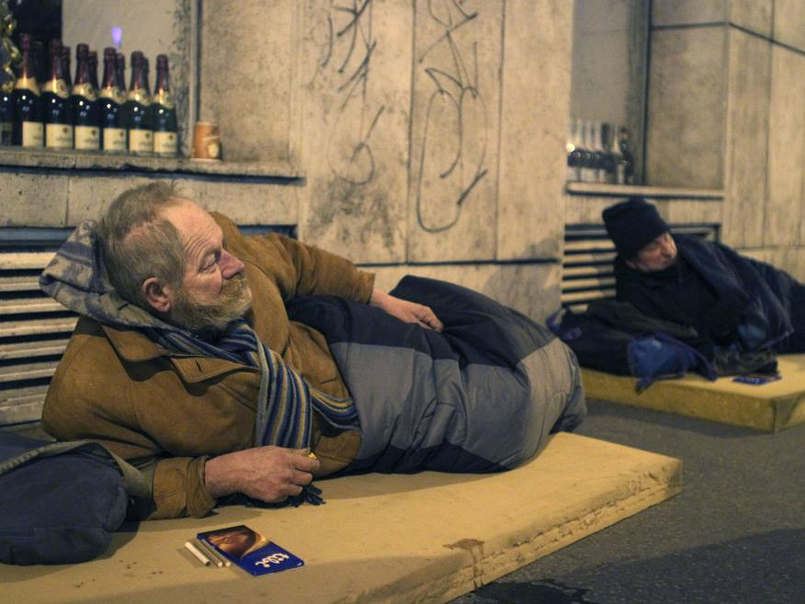
Watch the short video (1.44 mins) made by the NYU School of Law entitled:
How homelessness becomes a crime
(click on the link)

Slide 9
Take a look at the following diagram which shows how criminalising homelessness will simply create a vicious cycle and actually serve to increase homelessness.
Discuss your thoughts on this and what your own responses and reactions might be.

Slide 10
Charged with an offence
by police who issue a fine for the crime
Summoned to court
because unable to pay for the initial fine
No attendance in court
as lacking in money to pay court fees and unable to leave possessions unattended
Nowhere to go
therefore forced to “commit a crime” by sleeping on the street etc.
Criminal record
meaning restrictions now occur on finding:
Housing
Employment
Social support
Arrested and imprisoned
in order to “pay” for the crime that has been committed (e.g. sleeping on the street)

Slide 11
Is it a human right to have housing?
What do you think?
Reminding yourself of Maslow’s ‘Hierarchy of Needs’, talk with the person next to you and discuss whether you think we have a “right” to have a shelter or house to live in.
Share your ideas with the class.

Slide 12
Is it a human right to have housing?
According to Article 25 of the Universal Human Rights Declaration: Everyone has the right to a standard of living adequate for the health and well-being of himself and of his family, including food, clothing, housing and medical care’.
So in other words, YES, it is a human right to have housing.

Slide 13
So why do we have so many homeless people across the world?

Slide 14
HOMELESSNESS
T H I S S O R T O F L E A R N I N G
C A N ’ T W A I T

