Slide 1
G L O B A L
C U L T U R E S
CULTURAL IDENTITIES
Y9&10
13-15 years

Slide 2
W H A T I S C U L T U R E ?
W E E K 1
1 5 M I N U T E S

Slide 3
In this lesson, students will:
THINK!
Think about and discuss the concept of globalisation and its effect upon culture
Understand the impact of development and globalisation upon the loss of our own cultural identities
Explore and unravel some the positives and negatives of globalisation, thinking about the impact of monoculture upon communities and cultural identities
FEEL!
CONNECT!

Slide 4
P R E L E S S O N
R E F L E C T I O N S
3 – 5 M I N U T E S +

Slide 5
Introduce the following REFLECTIVE QUESTIONS for students to consider during the lesson:
What is culture and why is it important?
What are some of the biggest threats to cultures across the world?
What are cultural stereotypes and where do they come from?
What is globalisation and how is it affecting cultural diversity?

Slide 6
W H A T I S C U L T U R E ?
2 0 M I N U T E S +

Slide 7
Watch the short video (1.16mins) put together the Bureau of Educational and Cultural Affairs entitled:
What is Culture?
(click on the link above)

Slide 8
Allow students a few minutes to respond to the film with people sitting near to them.
After sharing their initial responses, look at four of the definitions of culture that were given (shown on the following slide).
Discuss each one and what you think it may mean:

Slide 9
I understand culture as a treasure that is a part of our collective memory of our perception of ourselves
Culture is something that unites people
Culture is the acquired pair of glasses through which we see life

Slide 10
What does culture mean to you?
Turn to the person next to you and come up with a definition of culture – think about how you understand your own culture in comparison to people from other countries.

Slide 11
C U L T U R A L
S T E R E O T Y P I N G
1 5 M I N U T E S +

Slide 12
Watch the short film (1.50mins) made by Positive Revolution TV entitled:
Avoid stereotypes whilst communicating
(click on the link above)

Slide 13
Allow students a few minutes to respond to the film with people sitting near to them.
After sharing their initial responses, ask them to consider the following questions:

Slide 14
Why is “Where are you from?” often one of the first questions we ask someone we meet someone for the first time?
What are some of the benefits and limitations of asking this question?

Slide 15
Discuss together other questions we could ask people when we first meet them, questions that would avoid us trying to use stereotypes and assumptions.
Share any ideas with the class.
Can stereotypes sometimes be useful when meeting people for the first time?

Slide 16
Popular entertainment and news media are very powerful in creating and spreading negative cultural stereotypes, especially about racial, cultural and ethnic groups.
Characters from non-dominant racial or cultural groups often fall into single stereotypes, and their storylines often follow the same narratives.
By doing this, the media representations of different cultures actively reinforces stereotypes and makes them more readily available in our minds.
Can you think of any examples of cultures or types of people who are stereotyped into roles?

Slide 17
What sort of roles do the following people usually get cast at within films or dramas (serving to perpetuate the cultural stereotype)?
Young black men | Young white men | Old Chinese men | Muslim men | Muslim women

Slide 18
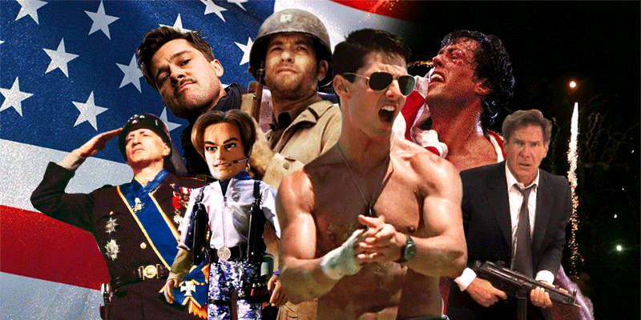
As well as promoting cultural stereotypes, the media also works to promote mono-culture (telling the world that one culture (e.g. western) is superior to all other cultures.
Across the world, people are exposed on a daily basis to:
American movies!
Western music!
The BBC!
Western consumer products!
Images of western celebrities!

Slide 19
Although this in itself is not a bad thing, it is a monopoly.
For example, we are not all equally being exposed to, for example:
South American movies
Japanese music
Indian news channels
Middle eastern products
Images of African celebrities

Slide 20
Media, advertising and consumerism doesn’t directly tell us that one culture (e.g. western) is better than any other, but by focusing constantly on one culture, it promotes this above all others.
What might the impact of this be on people’s perceptions of their own culture?
Why is western popular culture so well-exposed to the world?

Slide 21
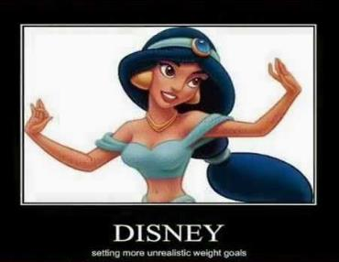
In order to transform our stereotypes, it is important to transform our popular culture into one that celebrates cultural diversity and that allows different cultures and people to be represented in many roles, just as westerners are.

Slide 22
GLOBAL CULTURES
T H I S S O R T O F L E A R N I N G
C A N ’ T W A I T

