Slide 1
G L O B A L
C U L T U R E S
CULTURAL IDENTITIES
Y11-13
15-18 years

Slide 2
T H E S I N G L E S T O R Y
W E E K 2
1 5 M I N U T E S

Slide 3
In this lesson, students will:
THINK!
Think about and discuss what it means to stereotype and the concept of cultural stereotypes
Understand and explore how our cultural stereotypes can directly impact the lives of people
Explore and unravel some of the stereotypes that exist within different communities, cultures and countries and think about how we can learn to re-think our preconceived assumptions
FEEL!
CONNECT!

Slide 4
P R E L E S S O N
R E F L E C T I O N S
3 – 5 M I N U T E S +

Slide 5
Introduce the following REFLECTIVE QUESTIONS for students to consider during the lesson:
What is a cultural stereotype and how are they created?
Is culture something that defines us?
How might stereotypes be restricting our ability to practise global citizenship?
Who or what is creating stereotypes or “single stories” about cultural identities?

Slide 6
S T E P P I N G O U T
O F F I C T I O N
1 0 M I N U T E S +

Slide 7
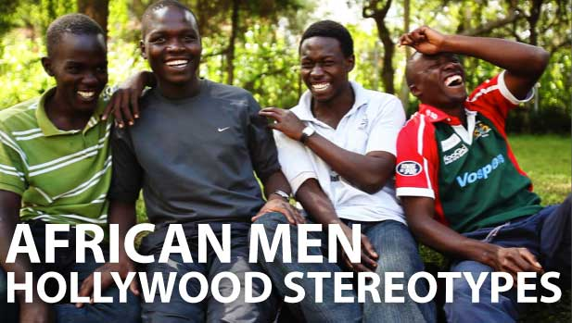
Watch the short video (2.40mins) made by Mama Hope entitled:
African Men – Hollywood Stereotypes
(click on the link above)

Slide 8
Allow students a few minutes to respond to the film with people sitting near to them.
After sharing their initial responses, ask them to consider the following questions:

Slide 9
Can you think of examples in popular culture where these stereotypes are perpetuated?
Why do you think this sort of cultural stereotyping happens within popular culture?

Slide 10
Popular entertainment and news media are very instrumental and powerful in creating and perpetuating negative cultural stereotypes, especially about racial, cultural and ethnic groups.
In television and film, characters from non-dominant racial and ethnic groups often fall into formulaic stereotypes, and their storylines follow the same old narratives.
The consistency of these representations reinforces stereotypes and makes them more readily available in our minds.

Slide 11
What sort of roles do the following people usually play (and thus perpetuate as a stereotype)?:
Young black men | Young white men | Old Chinese men | Muslim men | Muslim women

Slide 12
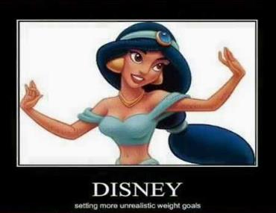
In order to transform our stereotypes, it is important to transform our cultural landscape into one that celebrates diversity through equality and that allows different cultures and people to be represented in all of the complicated roles that they inhabit, rather than relying on tired stereotypes.
Popular culture plays a vital role in this work, as it can be used to promote more nuanced and varied representations and can heavily influence people’s perceptions and understanding of cultural diversity.

Slide 13
The stereotypes that prevail about particular countries or cultures often come because of a limited amount of information that we have been exposed to about that place, culture or community.
Think about her own response to Mexico and Mexicans – this was a product of a single story being repeated constantly by the media.
What is the stereotypes that are perpetuated about the following places:
Syria
Russia
North Korea
Think about your own subconscious prejudice, and question whether you have started to believe that all people from these places are the same as the characters in your head…

Slide 14
The problem with stereotypes is not that they are untrue but that they are incomplete. They make one story become the only story.
Show a people as one thing – as only one thing – over and over again and that is what they become.
Would you agree with these thoughts here? Try and think of some of the many examples where this “single story” is being perpetuated in our modern media or popular culture.

Slide 15
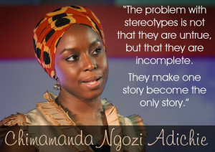
Take it further
Watch the incredibly inspiring and insightful Ted Talk (18.49mins) by writer and activist Chimamana Adiche entitled:
The danger of a single story

Slide 16
Take it further
If time allows, read one of the following articles which discuss the negativity and challenges of perpetuating stereotypes of the continent of Africa.
Discuss ideas raised within small groups:
Top 10 Problems with Africa (not the ones you were thinking)
Africans to Geldof: We don't need another Band Aid solution
Band Aid 30L Clumsy, patronising and wrong in so many ways
How to write about Africa
Is there a space for African experts?
How do you Challenge a Stereotype?
Talking about Africa
Barbie Saviour

Slide 17
GLOBAL CULTURES
T H I S S O R T O F L E A R N I N G
C A N ’ T W A I T

