Slide 1
GANGS
SOCIAL PERSPECTIVES
Y9&10
13-15 years

Slide 2
F O R T H E G O O D O F
T H E P A C K
W E E K 1
60 M I N U T E S

Slide 3
In this lesson, students will:
THINK!
Think about and discuss why people join gangs and what need in us this is satisfying
Understand the animalistic qualities within us that encourage pack mentality
Explore and unravel some of the behavioural patterns and moral choices that occur within gangs
FEEL!
CONNECT!

Slide 4
P R E L E S S O N
R E F L E C T I O N S
3 – 5 M I N U T E S +

Slide 5
Introduce the following REFLECTIVE QUESTIONS for students to consider during the lesson (maybe write them up or read them aloud and ask students to think about their own responses):
What is a gang and why do people join them?
What are some of the stereotypes surrounding gangs and where have they come from?
Why is the idea of a “gang” often seen as negative?

Slide 6
M O N K E Y
B E H A V I O U R
1 5 M I N U T E S +

Slide 7
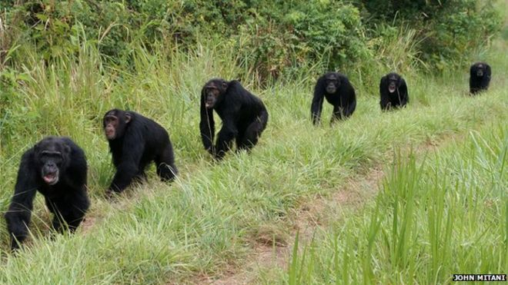
Watch the short extract (3.54 mins) from a documentary made by Planet Earth for the BBC looking at
The Violence of Chimps
Click on the link above for the hyperlink

Slide 8
Allow students a few minutes to respond to the film with people sitting near to them.
After sharing their initial responses, ask them to think about the following questions:

Slide 9
What does the clip show you about how chimps are similar to gangs?
Were you surprised by any behaviour in the clip? If so what and why?
Can you see anything in the clip that reminds you of human behaviour patterns?

Slide 10
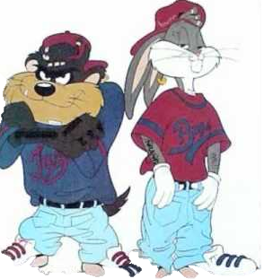
What is a gang?
Ask students to talk with the person (or people) next to them and come up with a one-line definition for a gang.
Share ideas with the class and see if you can come up with a common definition.

Slide 11
Read the short article on the following slides exploring how chimp gang behaviour is very similar in many ways to that of humans.

Slide 12
Murder 'comes naturally' to chimpanzees
By Jonathan Webb (Science reporter, BBC News)
18 September 2014
Taken from: http://www.bbc.co.uk/news/science-environment-29237276
A major study suggests that killing among chimpanzees results from normal competition, not human interference.
Apart from humans, chimpanzees are the only primates known to gang up on their neighbours with lethal results - but primatologists have long disagreed about the underlying reasons.
One proposal was that human activity, including destroying habitats and providing food, increased aggression. But the new findings, published in Nature, suggest this is not the case.
Instead, murder rates in different chimp communities simply reflect the numerical make-up of the local population.

Slide 13
The international study was co-written by more than 30 scientists and gathers data from some 426 combined years of observation, across 18 different chimp communities.
A total of 152 killings were reported. This includes 58 that were directly observed by researchers; the rest were counted based on detective work - tell-tale injuries or other circumstances surrounding an animal's death or disappearance.
Interestingly, the team also compiled the figures for bonobos, with strikingly different results: just a single suspected killing from 92 combined years of observation at four different sites. This is consistent with the established view of bonobos as a less violent species of ape

Slide 14
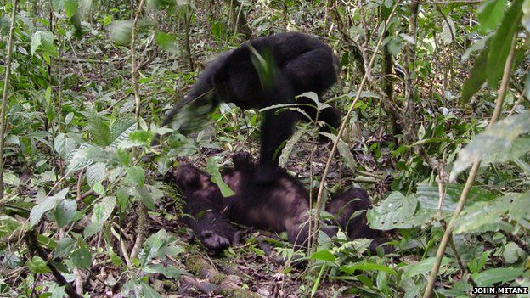
Killing the competition
The researchers' global compilation of chimp violent crime statistics allowed them to consider what conditions in a community produce a higher murder rate.
Chimpanzees live in well-defined colonies, and groups of males patrol the borders of each colony's territory. This is where violent conflicts are known to arise, particularly if a patrol encounters a single chimp from a neighbouring community - but never before has this much data on the lethality of those interactions been combined in a single study.

Slide 15
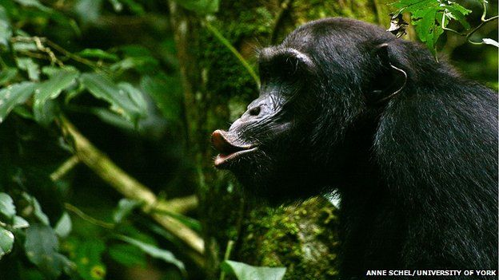
When the scientists compared the figures across chimpanzee research sites, they found that the level of human interference (e.g. whether the chimps had been fed, or their habitat restricted) had little effect on the number of killings.
Instead, it was basic characteristics of each community that made the biggest difference: the number of males within it, and the overall population density of the area.
These parameters link the violence to natural selection: killing competitors improves a male chimp's access to resources like food and territory - and crucially, it will happen more frequently when there is greater competition from neighbouring groups, and when the males can patrol in large numbers, with less risk to their own survival.

Slide 16
"It's a natural behaviour - it's not something that we've induced by disturbance or intervention," explained Dr Susanne Shultz, an evolutionary biologist at the University of Manchester. Dr Shultz was not involved in the study, but told BBC News the scale of the collected data was impressive. "There's a real effort to look across a really wide range of populations, and the results are very compelling and very thorough," she said.
Violent debate
In an accompanying commentary for the journal Nature, Prof Joan Silk from Arizona State University said the results "should finally put an end to the idea" that violence in wild chimpanzees was a product of human interference.
She suggested that our perceptions of our evolutionary cousins can sometimes be distorted, because we want to believe that it is the nice behaviours, not the nasty ones, which have deep evolutionary roots.There is no need to cling to such ideas, Prof Silk argues: "Humans are not destined to be warlike because chimpanzees sometimes kill their neighbours."

Slide 17
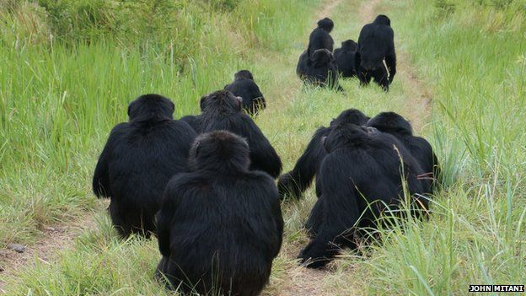
Prof John Mitani, a behavioural ecologist at the University of Michigan and one of the study's authors, agrees. "There is considerable variation in rates of killing by chimpanzees living in different populations, so even in chimpanzees killing is not inevitable," he said.
"And, of course, we are humans and not chimpanzees. We have the ability to shape and alter our behaviour in ways that they can't.“
Prof Frans de Waal, an animal behaviour expert from Emory University in the US, said the new study was an important contribution.
"I'm very glad they're publishing this," he told BBC News. It answers a "long, long history of resistance", Prof de Waal explained, to the idea of natural, inter-community violence in chimpanzees.
"It has always been contentious - we've had meetings where people screamed at each other.

Slide 18
"What this paper does is, instead of getting into the ideology and the history of these arguments... they have just taken the data and analysed it, and said: Where do the chips fall?"
The chips, in this case, appear to fall in favour of a natural history of violence.
But rather than having deep implications for human nature, the authors of the new study suggest that chimpanzee homicide - which previous research has estimated to occur at a similar rate to that seen in hunter-gatherer human societies - goes up and down as a simple consequence of competition for resources.

Slide 19
W H Y D O P E O P L E
J O I N G A N G S ?
2 5 M I N U T E S +

Slide 20
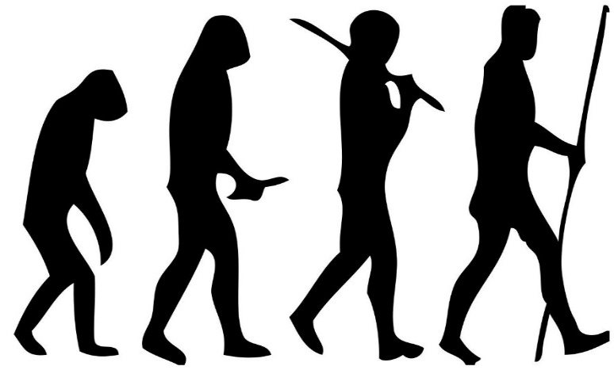
The emergence of gangs
Gang culture is not a new phenomenon. Gangs have been a part of society across the world for hundreds of years. Many people argue that gangs are just another form of tribal community, reasoning that our entire human history is based upon a form of gang-culture.
But why might people choose to join a gang in our modern society?

Slide 21
Why do people choose to join gangs?
Talk with the person next to you and come up with a few ideas – share these together with the group.

Slide 22
Were any of these on your list?
Fear or protection
Money or poverty
Ambition or adrenaline
Pushing boundaries
To be part of a community
Take a closer look at some of the reasons that people across the world have become part of a gang on the following slides.

Slide 23
1. A Sense of Belonging
We all share a need to feel we belong somewhere; if this is absent in daily life, a gang may well provide this support network.
Some people maybe don't receive enough support or attention at home and look to feel more connected with friends or groups.
Some may be trying to escape a negative home life, or looking for a role model or surrogate father/mother figure.
Gangs often make promises to give unconditional support, and to become the "family" the members never had.

Slide 24
Do you think this is a common reason for people to join a gang?

Slide 25
2. A Desire for Protection
There are communities across the world that have very high levels of gang activity, and this often leads to people joining a gang just to survive.
Often it becomes easier to join the gang than to remain vulnerable and unprotected in the neighbourhood. In these instances, it is often a very difficult choice for people to make.

Slide 26
Do you know of anyone joining a gang because of the need for protection?

Slide 27
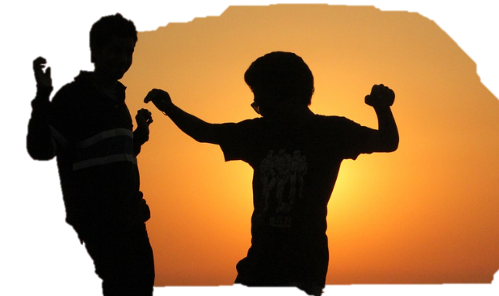
3. Peer Pressure
Across the world, young people (teenagers in particular) face a constant pressure to fit in. Part of the nature of peer pressure is not having support needed to avoid pressure to conform, and this can lead people to make choices beyond their own wishes.
Peer pressure may come in the form of intimidation or coercion; be part of a dare; could be a form of harassment or even friendly persuasion or endless begging.

Slide 28
How common do you think peer pressure is in influencing people to join gangs?

Slide 29
4. Poverty
Many people find themselves joining gangs due to a lack of jobs and opportunities in their community. For many, working within a gang may present a means of survival to someone lacking basic essentials such as food, clothing and shelter.
It may also open up opportunities to make money, engaging in a range of legal or illegal activities.

Slide 30
How else might money influence people’s choices surrounding gang culture?

Slide 31
5. Following Family Traditions
Families sometimes have a history of gang involvement spanning over a number of generations, and there is an almost unspoken expectation that children will follow suit. This is one of the toughest forms of pressure to escape, as the gang lifestyle may be very deeply rooted within core traditions and values within the family.

Slide 32
Do you think this is a common reason for people to join a gang?

Slide 33
6. Pushing boundaries
Many young people are looking for boundaries, and they will push the boundaries until they reach a wall they are either unable or unwilling to break down.
This behaviour is (for many) an essential part of the process of growing up and becoming a moral, law abiding member of society.

Slide 34
Have you seen this happen with anyone you know?

Slide 35
7. Adrenaline
Many young people get a rush out of defying authority, engaging in illicit behaviour or even committing crimes. The attraction of gang lifestyle is that it often lives outside of conventions, laws and boundaries and encourages engagement in a range of illicit activities and behaviours.

Slide 36
Do you think this is a common reason for people to join a gang?

Slide 37
8. Finding Shared Beliefs
We all like to feel connected to people who share our beliefs or ways of thinking in some ways. For some, joining a gang allows a community to form of like-minded people, who can spend time together talking and sharing the ways in which they see the world.

Slide 38
Do you belong to a group, community or gang? Is this an inherent human need do you think?

Slide 39
W H A T I S M O B
M E N T A L I T Y?
2 0 M I N U T E S +

Slide 40
Whilst being part of a pack, herd, swarm or group is a positive for survival, the term “herd mentality” or pack mentality when applied to humans is often used because of something negative.
What does herd mentality mean when talking about humans?
Can you think of an example of herd or mob mentality in humans?

Slide 41
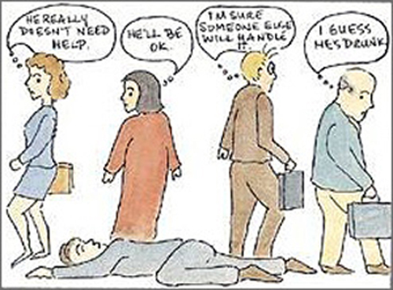
Watch the short video (3.35mins) made by Cool Psychologist entitled:
The Bystander Effect
Click on the link above for the hyperlink

Slide 42
Allow students a few minutes to respond to the film with people sitting near to them.
After sharing their initial responses, ask them to think about the following questions:

Slide 43
Why do you think it is much easier to be a part of a group than it is to be an individual doing something different?
Talk to the person next to you and then share ideas with the class.

Slide 44
“People feel safe in a herd, and safer and happier in a herd/tribe that dominates all the other herds/tribes in a particular geographical area they live in. It gives them a sense of security and pride; a behaviour also be amongst animals...
“Morality is inversely proportional to the number of observers. When you have a large group that's relatively anonymous, you can essentially do anything you like."
Dr James Thompson, Psychologist

Slide 45
Take a look at the blog post written by Racles Bogdan (printed on the following slides) exploring the impact of mob mentality on our actions in many unknown and unrealised ways.
https://bqsuvt.wordpress.com/2012/10/14/our-unknown-enemy-mob-mentality/

Slide 46
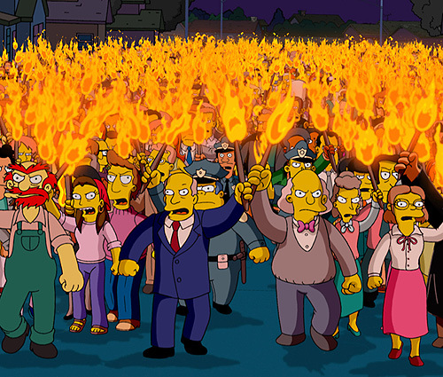
Our Unknown Enemy: Mob Mentality
There have been times in our lives when we’ve heard the expression ‘if your friends jumped off a cliff, would you do the same?’ from our parents or our teachers. We answered with ‘no’ most of the times.
The reality is that, every now and then, without realizing why, we would jump with our friends. People follow people. It’s been like this for ages. The reason we blindly follow people is because we lose our sense of individuality and become part of a group’s mechanism. Most of the times, there are negative outcomes when this happens. Football fights, military units, witch trials, all of these are examples of why acting without individual thinking is wrong.
You can do something about mob mentality.

Slide 47
“Many who participated in the riots were confronted with scenes that challenged their conscience. A 17-year-old from Islington who, on the second night of the riots, looted a branch of Currys in Enfield, described how her feelings changed as the night progressed. When people she knew smashed their way into a hairdresser’s, stealing shampoo and ripping out the basins, she thought: ‘It’s so dumb. I don’t agree with it.’”
Let’s analyse the London riots, for example. At the beginning of August 2011 some London districts suffered rioting, looting and arson when thousands took the streets, during a protest that turned violent.
An extract from an article found in The Guardian newspaper stated:

Slide 48
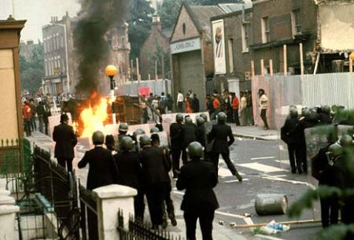
Does disagreeing actually matter? Yes, it does. If you see mobs as an irrational phenomenon, the first response is to repress (why reason with those who have no reason?) and second is to look for problems within the communities from which rioters are drawn. There are ways in which you can say “No, I won’t jump”. Understanding how belonging to a group can influence our thoughts helps us make sense of the behaviour that otherwise will appear irrational and has fundamental implications in how we respond to crowd actions.
We should start asking ourselves why is it so easy for humans to act violently when belonging to a group? The idea of mob mentality was first coined by social psychologist Gustave Le Bon [1], when referring to the belief that a group can act as a single individual. This leads most of the time to destructive behaviour.

Slide 49
The London riots were only the start in a chain of riots that happened in the next three nights all across England. Significant disturbances, involving rioting and looting, were reported in Birmingham, Salford, Liverpool, and Manchester. The capability to control behaviour disappears, therefore exposing individuals to contagion. All acts of love, hatred, anger are immediately approved, spread and repeated.
Have you ever been in a group and acted in a way contrary to your ordinary behaviour? A man, as part of a group, is a very different individual. When studying the effects of behaviour of individuals in a revolution, Le Bon [2] thought that the collective mentalities are very different than personal mentalities. In a mob mentality the individual’s identity disappears, causing anonymity.

Slide 50
Simply by being part of a crowd, folks lose all sense of self and all sense of responsibility, and manage to gain power due to the group’s size. Behaviour in a crowd is mostly influenced by anonymity. Nobody knows who you are when you stand next to a large number of people.
Diener [3] conducted a study on how anonymity influences ones behaviour in a group by observing children that went trick-or-treating on Halloween. The results of the study indicated that children who wore costumes that concealed their identity, or children who went trick-or-treating in a group stole extra candy compared to when they were alone with the candy bowl.
So, anonymity enhances the loss of self-awareness within a group that eases the path to anti-social behaviour and encourages individuals to identify with the group. If people don’t know you, there will be fewer consequences for your actions.

Slide 51
Anonymity and loss of individuality eases up the process of behaving anti-social. Festinger, Pepitone and Newcomb’s [4] used the term “deindividuation” to describe the effect of groups on the behaviour of an individual. They stated that when belonging to a crowd, a person will be ‘able to indulge in forms of behaviour in which, when alone, they would not indulge’.
Think about how easy it must have been for the participants at the London riots to loot stores in groups rather than when they are be alone. Including one person in a crowd or a group results in the feeling of anonymity and loss of personal identity, which motivates people to act aggressively or deviate from their usual social behaviour.
Humans tend to exhibit certain behaviour when they become members of a group. A group can shape our conformity, and influence our decision making, or even threaten us with ostracism if we do not agree with the overall decisions made by the group.

Slide 52
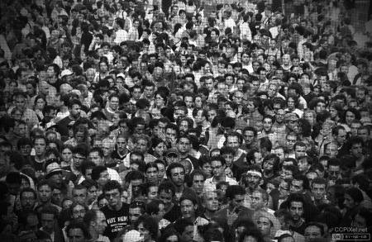
Understanding mob mentality can be the first step in stopping the negative outcomes. The solution lies in preventing deindividuation, rather than punishing the results. For instance, what did the authorities do after the London riots? They started repressing rioters. This was wrong.
A different approach should have been taken such as helping individuals become more self-aware. There are experiments with mirrors [5] which have proven that people become more self-aware of their actions. By forcing an individual to see himself, you force him to think about his actions, and that increases self-awareness and decreases deindividuation.

Slide 53
This was applicable for preventing riots at football matches, where mirrors and cameras have been placed on the walls stadiums. Additionally, it is important to stop unruly behaviour from its early stages. One way to do this is by reinforcing their individual identity. Simply by calling people by their name, pulling them out of a mob and encouraging personal differences in a group can reduce the harmful effects of deindividuation.
If you manage to create non-threatening, non-stressful, and unambiguous situations people may think more clearly about their actions instead of being drawn in by negative group norms.
References
[1] Le Bon, G., (1896) General Characteristics of crowds – Psychological Law of Their Mental Unity. The Crowd: A study of the Popular Mind. Book I, Chapter I.
[2] Le Bon, G., (1913) The Psychology of Revolutionary Crowds, The Psychology of Revolution, 4, 57-63
[3] Diener, E., Fraser, S., Beaman, A., & Kelem, R. (1976). Effects of deindividuation variables on stealing among Halloween trick-ortreaters. Journal of Personality and Social Psychology, 33, 178- 183.
[4] Festinger, L., Pepitone, A., & Newcomb, T. (1952). Some consequences of deindividuation in a group. Journal of Social Psychology, 47, 382-389.
[5] Asendorpf, J.B., Warkentin, V., & Baudonniere, P.M. (1996) Self-Awareness and Other-Awareness II: Mirror Self-Recognition, Social Contingency Awareness, and Synchronic Imitation, Developmental Psychology, Vol.32, No, 2,313-321

Slide 54
Were there any statements made that you thought interesting or controversial?
Have you ever been in a group and acted in a way contrary to your ordinary behaviour?

Slide 55
Look at the following statement:
“Morality is dulled when we are part of a larger group”
Split the class in half and arrange each half into small groups of no more than 4 people.
Give one side of the room the “for” and one the “against” argument in response to the statement

Slide 56
To help, why not use some or all of the nine articles on the following slide (maybe spread around the groups) to support the ideas to extend the activity.
Allow students to work in their groups for 5-10 minutes, noting down ideas and thinking of counter-arguments.
Either run as a formal debate or as a more general class discussion.

Slide 57
1.The effect of mob-mentality on the brain | 2. Herd behaviour | 3. What turns people into looters?
4 Getting into the mind-set of mob-mentality | 5.The London riots – man jailed for 6 months for stealing water bottle | 6.When good people do bad things
7.Mob-mentality brain suppression | 8.Mob mentality in Lord of the Flies *Relevant to those in the class who have studied William Golding’s text | 9.Lord of the Flies – Simon chapter *Read this if time at the end – relevant to those in the class who have studied William Golding’s text

Slide 58
G A N G S
T H I S S O R T O F L E A R N I N G
C A N ’ T W A I T

