Slide 1
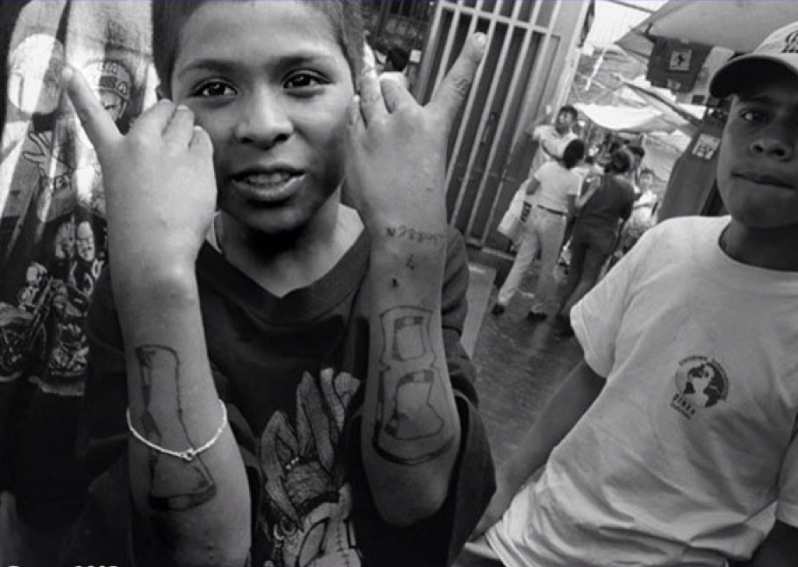
GANGS
SOCIAL PERSPECTIVES
Y11-13
15-18 years

Slide 2
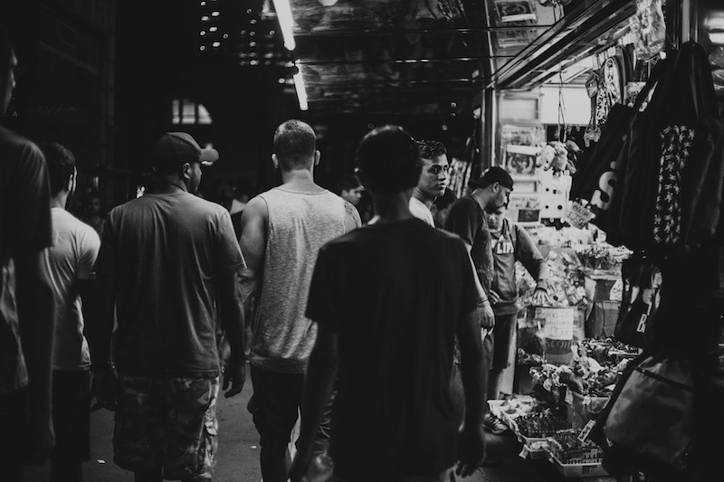
G A N G S O F
E L S A L V A D O R
W E E K 2
30 M I N U T E S

Slide 3
In this lesson, students will:
THINK!
Think about and discuss the pressures within society that encourage people to join gangs
Understand how social inequality and political corruption can influence behaviour within particular cultures and countries
Explore and unravel some of the stereotypes that exist within our perceptions of gang members and gang culture
FEEL!
CONNECT!

Slide 4
P R E L E S S O N
R E F L E C T I O N S
3 – 5 M I N U T E S +

Slide 5
Introduce the following REFLECTIVE QUESTIONS for students to consider during the lesson (maybe write them up or read them aloud and ask students to think about their own responses):
What is “gang loyalty” and what do you think it means?
Can a gang’s behaviour influence a societal change?
What links are there between gang violence and societal dysfunction?

Slide 6
R I V A L R I E S
B E H I N D B A R S
2 5 M I N U T E S +

Slide 7
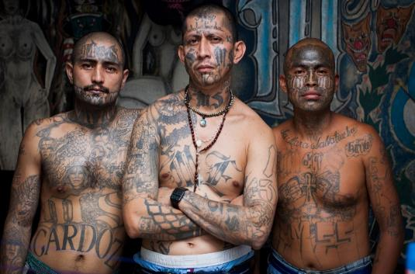
Watch the short documentary (23 minutes) made by Adam Hinton looking at the Mara Salvarucha gang in El Salvador entitled:
MS-13
Click on the link above or copy and paste this hyperlink:
https://vimeo.com/137759704)
Please note that this video contains footage
that some may find disturbing, including the
funeral of a gang member and the dead
body of a young baby. It also contains footage of gang members smoking marijuana and brandishing guns.

Slide 8
Allow students a few minutes to respond to the film with people sitting near to them.
After sharing their initial responses, ask them to think about the following questions:

Slide 9
What did you learn within the film about gang culture in El Salvador?
What did you learn within the film about society in El Salvador?
What did you find most surprising or shocking within the film? Why

Slide 10
T A K E A C L O S E R
L O O K
5 M I N U T E S +

Slide 11
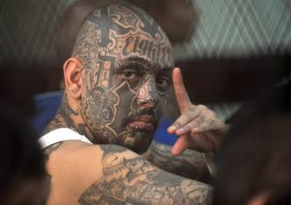
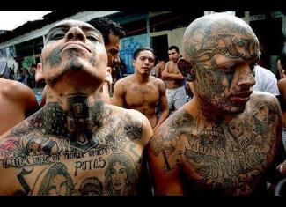
*Images courtesy of Adam Hinton
There are two main rival gangs working in El Salvador:
If time allows, take a look at the following information sheets on the two gangs working in El Salvador to find a bit more about the people involved.
18th Street
MS-13

Slide 12
*Images courtesy of Adam Hinton
Fact-file on MS13 (click here)
Fact-file on 18th Street (click here)
*or alternatively read the fact files together on the following slides

Slide 13
18th Street Fact-file
1. 18th Street Gang is a multi-ethnic organisation that started as a street gang in Los Angeles, California. They are also known as Barrio 18.
18th Street Gang
2. While some accounts trace its origins to the late 1950s, the gang began to take its current form in the 1980safter splitting from the Clanton 14 gang.
3. The 18th Street gang has grown by expanding its membership to other nationalities and races, and it was among the first multiracial, multi-ethnic gangs in Los Angeles.

Slide 14
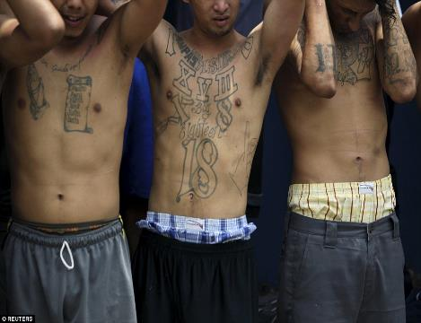
4. In the beginning, they were made up largely of second-generation Hispanics but as they began to battle with more established Hispanic gangs, they began to recruit outside the Hispanic community.
5. Mass deportation of Central Americans allowed gang numbers to grow rapidly. Most Members of 18th Street are now Central American mainly Salvadoran, Guatemalan, and Honduran.
6. The 18th Street gang became a bitter rival of MS-13, another prominent gang, as both gangs wanted the top spot in Central America.
18th Street Gang

Slide 15
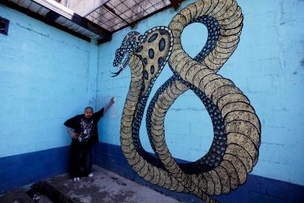
7. 18th Street gang members are required to abide by a strict set of rules. Failure to obey the word of a gang leader, or to show proper respect to a fellow gang member, may result in an 18 second beating, or even execution for more serious offenses
8. 18th Street gang members often identify themselves with the number 18 on their clothing and use the symbols XV3, XVIII, X8, 666, 99 (9+9=18), and 3-dots in their graffiti and tattoos.
18th Street Gang
9. 18th Street colours are blue and black; blue is to represent and to pay tribute to The Mexican Mafia, and black is to represent the original colour for the gang.

Slide 16
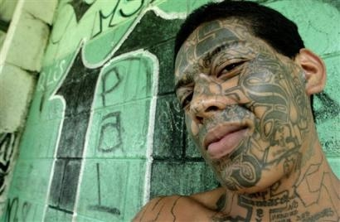
10. The 18th Street gang is occasionally referred to as the Children's Army because of its recruitment of elementary and middle-school aged youth. They also
allow other races to join their ranks making the gang Multi-ethnic.
11. In El Salvador it is common for members of the gang to be tattooed on the face with a large "18". In many cases the tattoo covers the entire face.
12. Throughout the region, the gang is known for a strict insistence on loyalty in its ranks, and often kills to punish transgressions.
18th Street Gang

Slide 17
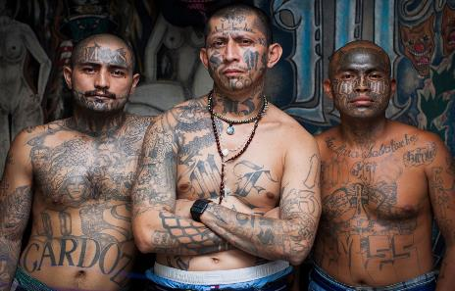
Mara Salvatrucha (MS-13) Fact-file
1. The MS-13 was founded in the “barrios” of Los Angeles in the 1980s. The gang was initially made up of refugees from El Salvador living in the Pico Union neighbourhood.
2. The name comes from El Salvador: Marais a Central American term for gang; Salvarefers to El Salvador; Trucha, (which means “trout” in English) is a slang term for “clever” or “sharp.”
Mara Salvatrucha (MS-13)
3. MS-13 has spread to other parts of the United States, Canada, Mexico, and Central America. The majority of the gang is ethnically composed of Central Americans(mostly Salvadorans)

Slide 18
4. They are notorious for their use of violence and a binding moral code of allegiance.
5. Entry to the gang is often violent, including a 13 second beating that can often end in tragedy.
6. Originally, the gang's main purpose was to protect Salvadoran immigrants from other, more established gangs of Los Angeles.
Mara Salvatrucha (MS-13)

Slide 19
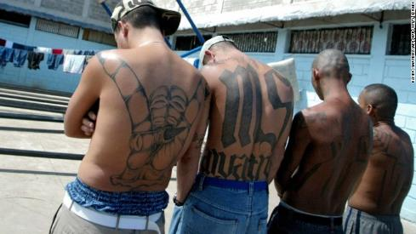
7. The gang is estimated to have 30,000 to 50,000 members and associate members worldwide, 8,000 to 10,000 of whom reside in the United States.
8. The leaders are known as palabreros, which is translated to mean “those who have the word.” These leaders control what are known as cliques, the cells that operate in specific territories
Mara Salvatrucha (MS-13)
and can control the actions of these cliques from afar.
9. Many Mara Salvatrucha members cover themselves in tattoos. Common markings include "MS", "Salvatrucha", the "Devil Horns", the name of their clique, and other symbols.

Slide 20
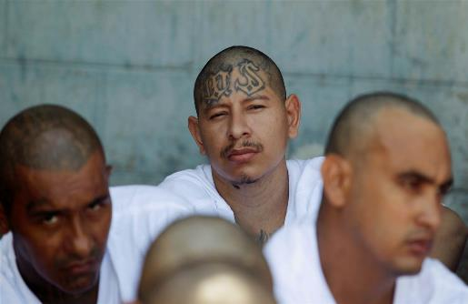
10. As well as distinguishing themselves by tattoos covering their body and also often the face, they have a unique brand of sign language.
11. One of the most commonly displayed hand signs is the devil's head which forms an 'M' when displayed upside down.
12. The MS-13 is enemies with 18th Street Gang (or Barrio 18), another street gang with an extensive presence in Central America, Mexico and the United States.
Mara Salvatrucha (MS-13)

Slide 21
The Izalco jail in south west El Salvador is very similar to the Penas Cuidad jail, but this jail is run by the opposing gang, the 18th Street.
Click here to watch a short (2.39mins) introduction to the Izalco jail (home to 18th Street)
Click here to watch a short (3.24mins) introduction to the Penas Ciudad Barrios (home to MS-13)

Slide 22
After watching the short videos and reading the fact-files, discuss the following questions in small groups:
Why might the government have allowed the gangs to take over the prisons?
What have you learned about gang loyalty from these two gangs? What are your reactions?

Slide 23
G A N G S
T H I S S O R T O F L E A R N I N G
C A N ’ T W A I T

