Slide 1
C L O T H E S
ENVIRONMENTAL ENGAGEMENT
Y11-13
15-18 years

Slide 2
S L A V E S T O F A S H I O N
W E E K 2
3 0 M I N U T E S

Slide 3
In this lesson, students will:
THINK!
Think about and discuss where our clothes come from and the link between cost and worth within the clothing industry
Understand some of the human stories of slavery behind the creation of fast fashion
Explore and unravel some the negative ripple effects of our cheap clothing industry on individuals, communities and environments cross the world
FEEL!
CONNECT!

Slide 4
P R E L E S S O N
R E F L E C T I O N S
3 – 5 M I N U T E S +

Slide 5
Introduce the following REFLECTIVE QUESTIONS for students to consider during the lesson:
Do you ever wonder where your clothes come from?
Why do you think we are able to buy some clothes very cheaply?
Do you think consumers should be responsible for ensuring their clothes are ethical and “slave free”?

Slide 6
T H E T R U E C O S T O F O U R C L O T H E S
1 0 M I N U T E S +

Slide 7
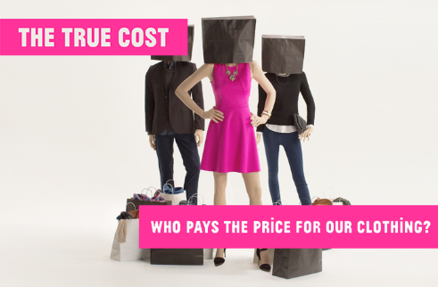
Watch the trailer (2.34 mins) for the documentary directed by Andrew Morgan entitled:
The True Cost
(click on the hyperlink above)
Allow students a few minutes to respond to the film with people sitting near to them.
After sharing their initial responses, ask them to consider the following questions:

Slide 8
“Why is an industry which is generating so much profit unable to support its workers?” This is a question raised in the trailer. What do you think some of the reasons might be?

Slide 9
Take it further…
If interested, the full documentary of The True Cost (92 mins) can be accessed by clicking here.

Slide 10
S L A V E S T O
F A S H I O N
2 0 M I N U T E S +

Slide 11
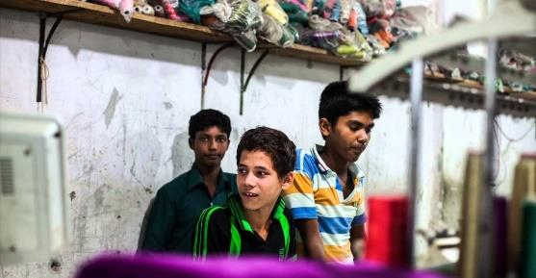
Watch this short film (2.15mins) made by news organisation Toronto Star entitled:
Factory Kids
(click on the hyperlink above)
Allow students a few minutes to respond to the film with people sitting near to them.
After sharing their initial responses, ask them to consider the following questions:

Slide 12
What problems need to be addressed along the chain do you think?
What responsibilities do you have as a consumer?

Slide 13
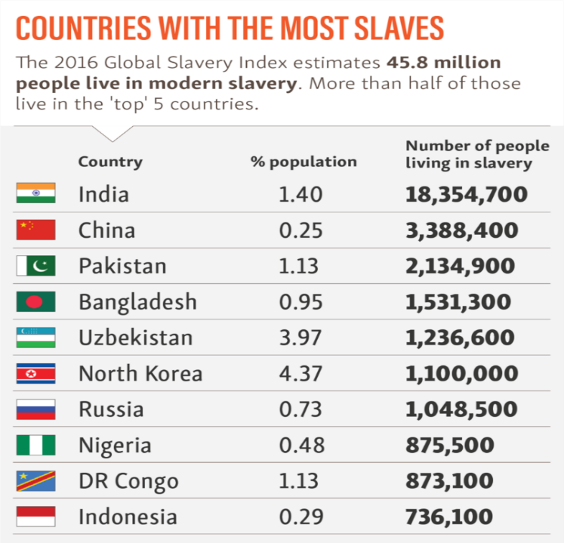

Slide 14
Look closely at the table which outlines the estimate number of people living in slavery in the world.
What surprises you the most about these statistics?

Slide 15
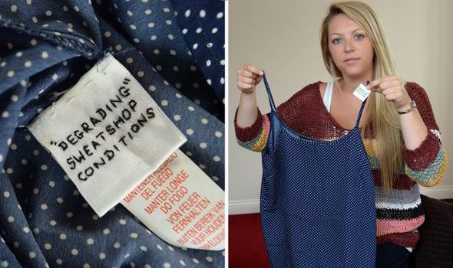

Slide 16
This is a picture of a label that was found inside a garment purchased in Primark two years ago containing a “cry for help” message from a garment worker in the factory where the t-shirt was made.
Look again at the picture, and also at the image on the next slide of a note, hidden inside a pair of trousers alleging slave labour conditions in a Chinese prison.
It was found wrapped in a prison identity card, and claimed inmates were forced to work 15 hours a day making clothes.

Slide 18
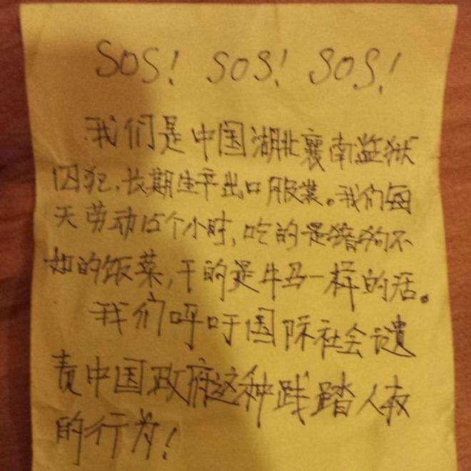
This note was found inside a pair of trousers in Belfast.
The writer of the note claimed inmates were forced to work "like oxen" and were given food that would be considered unfit for animals.

Slide 19
Think about these images and now read the short article printed on the following slides entitled The Hidden Face of Primark Fashion, exploring some of the issues uncovered in Primark stores.
After reading, ask students to share their responses:

Slide 20
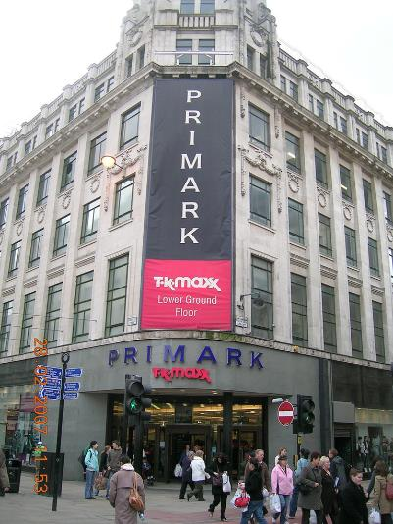
The hidden face of Primark fashion Dan McDougall in Tamil Nadu, India Sunday 22 June 2008
The huge fashion store Primark sacked three of its suppliers last week after an investigation for the BBC's Panorama and The Observer uncovered children labouring in Indian refugee camps to produce some of its cheapest garments. Here we reveal the brutal reality of a supply chain that sees children as young as 11 sewing T-shirts which cost shoppers just a few pounds to buy on high streets across Britain.

Slide 21
When Primark was launched, its flagship store in London's Oxford Street was besieged by stampeding bargain-hunters and sold more than a million garments in its first 10 days. The opening drew a bigger crowd than that managed by Topshop's much-hyped launch of its Kate Moss collection, which featured the supermodel herself moodily posing in its windows. Fashion bible Vogue gave a Primark jacket high-end credibility.
Last week, in an announcement that effectively pre-empted publication by The Observer of this investigation, Primark announced it had sacked three of its clothing suppliers in India after being told by the BBC's Panorama programme of evidence that it was subcontracting labour to child workers. The investigation found that in the refugee camps of southern India young children had been working long hours in foul conditions to sew the designs that will see, at current growth rates, Primark eclipse Marks & Spencer as Britain's biggest mass-market fashion retailer by 2009, taking £1 of every £10 spent on clothing in the UK.

Slide 22
Other major retailers are scrambling to follow the cheap, fast and fashionable concept - for good reason. Worth an estimated £5bn, the Primark chain now has 4.8 million sq. feet of retail space across 177 stores in three countries, employing 25,000 people. But as this child labour scandal shows, the Irish conglomerate, which sells one in every 10 items of clothing bought in Britain today, had little control over part of its supply chain. Campaigners are now demanding that the UK government acts to force companies to be responsible for the welfare of workers all the way down their tangled supply chains.
Primark sacked the three suppliers before being hit by a wave of negative publicity inevitably coming its way from the documentary. The firm, owned by Associated British Foods, said it had made the statement to fulfil a responsibility to shareholders, not - as cynics suggested - to lessen the shock of an international exposé. The retailer said that, as soon as it was alerted to the practices over a month ago by The Observer and the BBC it cancelled new orders with the factories concerned and withdrew thousands of garments from its stores.

Slide 23
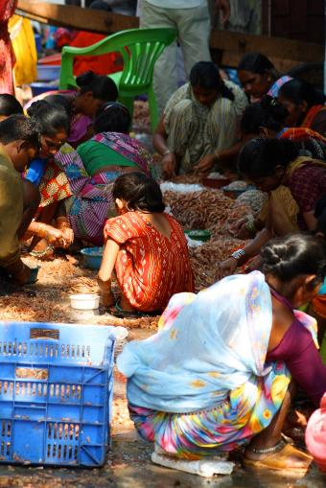
The speed at which Primark acted may mean that its standing in the high street remains secure, its reputation repaired before many of its customers will have even noticed it was tarnished. But at the other end of the world nothing has changed for those tiny links in the chain of supply that is meeting the British appetitive for cheaper and cheaper clothing: children like Mantheesh, who works for one of the sacked suppliers.
At 11 her life is already an extraordinary story of survival. An orphan, this Tamil refugee had fled the bombings of Sri Lanka only to find herself abandoned by an opportunistic trafficker on a sandbank 10 miles off land. Exhausted and dehydrated, in the middle of the treacherous Palik Strait, the channel between India and Sri Lanka, she was rescued by fishermen just as the tide was closing over her.

Slide 24
Mantheesh ended up at India's Mandapam transit camp, a fenced-off series of dilapidated, one-storey cement blocks, 12 miles from the flat Arichalmunai beachfront, the first port of call for Sri Lankan refugees brought in by smugglers. She traced the path of thousands of her fellow refugees, moving north to the camps of the major textile industry region of Tamil Nadu where menial jobs are available to those desperate enough to take them. Mantheesh went to Bhavanisagar camp, 60km from Tirapur. Within months she was absorbed into India's burgeoning economy, hand sewing from dawn to dusk for a businessman who had shrewdly recruited hundreds of refugees on the cheap to make garments destined for half a dozen European firms, including Primark.
Working for The Observer over the past three years, I have helped expose several of the world's major retailers: Otto-Heine, the largest online fashion retailer in Europe; Esprit, the world's fifth largest clothing store; and Gap Inc, one of the most iconic modern brands, all for employing children. Each firm, without its knowledge, had used Indian contractors with scant regard for the consequences of subcontracting.

Slide 25
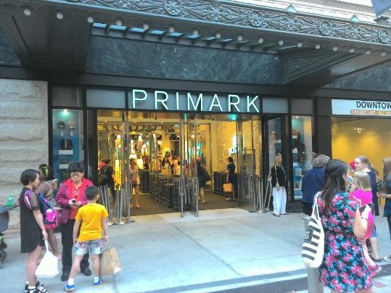
Carrying out an Observer investigation into child labour last year, I was badly beaten for being found inside a sweatshop in the lawless Haryana state border area of northern India. An angry mob chased me through the ancient alleyways, a no man's land for foreigners and police. They smashed photographic equipment and threatened to kill my translator, who had his eardrum perforated in the attack.
According to Bhuwan Ribhu, lawyer with the Global March Against Child Labour, which has had activists murdered by sweatshop gangsters, the fight to expose child labour is increasingly dangerous for both journalists and activists. This, he claims, is one of the key reasons many big names in fashion escape international exposure.

Slide 26
'What consumers need to understand is it is an impossible task to track down all of these terrible sweatshops and factories employing children, particularly in the garment industry when you need little more than a basement or an attic crammed with children to make a healthy profit. The police have to rely on rare tip-offs because it is difficult to track down child workers. Even before the search parties get to the factories the owners are tipped off and many of the children are cleared out,' he said.
'More daring unit owners even hide the children in sacks and in carefully concealed mezzanine floors designed to dodge such raids. We have lost a number of activists, murdered in the course of their duties. Others have been dragged in chains behind cars.'
Now, after a seven-month undercover investigation into India's sweatshop misery for Panorama, Primark is added to the growing hall of shame of retailers proven to have had children making their clothes. Read the full article here.

Slide 27
Explore more by visiting the Walk Free website, or learning more facts about slavery and its impact on our clothing by reading one of the articles below:
Who made your clothes? It’s time we knew and cared.
Global forces involved in t-shirt production
Modern slavery facts

Slide 28
C H A N G I N G
F A S H I O N S
5 M I N U T E S +

Slide 29
How can we become ‘smarter shoppers’? What can we do on an individual basis to support ethical fashion?

Slide 30
Take a look at the 5 top tips to change the way you shop from Fashion Revolution on the following slides and discuss whether you think you could apply these to your own habits.
After reading, discuss further ways they think that we (as individuals) can act to work to prevent the unethical chains of slavery in fashion. Make a list of your own 5 top tips to change the way you shop

Slide 31
#1 WILL YOU WEAR IT 30 TIMES?
The rapid turnover of trends characterising Fast Fashion means clothes are disposable. Along with the deflation of clothing prices this has put the supply chain under unprecedented pressure leading directly to outrages like Rana Plaza and Tazreen (the 2012 Dhaka fashion factory fire that killed over 1000).
Just asking yourself if you will wear a prospective item 30 times is a great place to start shopping smarter and more intentional.

Slide 32
#2 BREAK THE CYCLE:
The traditional spring/summer autumn/winter of international fashion week is simply made up to sell more clothes, it is all just for show.
Zara, the Spanish fast fashion behemoth broke the mould, introducing mini seasons every week. 50-100 new micro seasons a year is the new normal. So slow down your fashion cycle and don’t be lured into thinking you have to change things because somebody told you to.

Slide 33
#3 SPREAD YOUR FASHION DOLLARS:
The global fashion industry is worth $2.5 trillion. Shouldn’t this be shared around? Look for producer-centric brands like People Tree, which is run to rigorous Fairtrade standards, or organisations with longstanding producer groups who get a fair share of the profits. It is not hard nowadays to find fairly traded fashion, you just have to look for it.

Slide 34
#4 DETOX YOUR WARDROBE:
Fashion is the world’s second most polluting industry after oil. Notably, Azodyes are still the most used synthetic dyes despite being toxic. 10% of the world’s biggest fashion brands have committed to phasing out toxic substances through Greenpeace’s Detox programme. Check the fabrics that you are buying and think about recycling/ upcyling clothes, rather than always buying new or throwing away.

Slide 35
#5 JOIN THE FASHION REVOLUTION:
Be the change you want to see in your wardrobe (to paraphrase Gandhi). Fashion Revolution (fashionrevolution.org) represents millions of consumers who want change and also commemorates Rana Plaza by putting pressure on the brands to increase transparency and empowers consumers to be inquisitive about #whomadetheirclothes.

Slide 36
Take it further
If time allows, take a look at a range of organisations, articles and videos exploring the issue of slavery within the textile industry:
Fashion Revolution (website)
Slave to Fashion (article)
Garment workers in Bangladesh (video)
Behind the scenes at Nike (video)
Tragedy in Bangladesh (article)

Slide 37
C L O T H E S
T H I S S O R T O F L E A R N I N G
C A N ’ T W A I T

