Slide 1
GANGS
SOCIAL PERSPECTIVES
Y7&8
11-13 years

Slide 2
N E E D I N G T O B E L O N G
W E E K 4
15 M I N U T E S

Slide 3
In this lesson, students will:
THINK!
Think about and explore sub-cultures and the identities that we assume within these cultures
Understand how sub-cultures are an important part of our identity and allow us to feel connected to other people
Explore and unravel how gang tension and cohesion can influence communities and countries
FEEL!
CONNECT!

Slide 4
P R E L E S S O N
R E F L E C T I O N S
3 – 5 M I N U T E S +

Slide 5
Introduce the following REFLECTIVE QUESTIONS for students to consider during the lesson (maybe write them up or read them aloud and ask students to think about their own responses):
Are you part of any groups?
How important are they to allow you to be who you are?
How do you create your identity within those groups?
Is being part of a group a human need?

Slide 6
F I N D I N G O U R
T R I B E
5 M I N U T E S +

Slide 7
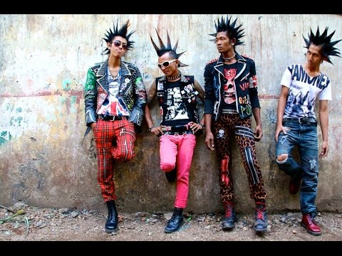
Watch the short video (3.18mins) put together by ThoughtBox entitled:
A-Z of Subcultures
click on the link above for the hyperlink

Slide 8
Allow students a few minutes to respond to the film with people sitting near to them.
After sharing their initial responses, ask them to think about the following questions:

Slide 9
What is the difference between a subculture and a gang?

Slide 10
W H E R E D O W E A L L B E L O N G ?
1 0 M I N U T E S +

Slide 11
A quick history of our tribalism…
Humans are social creatures, shaped by evolution over several million years to live in small tribes.
Since modern humans evolved, the largest (almost 90%) of human history sees us living in small groups and roaming the land as hunter-gatherers, still living and roaming together in small communities or tribes.

Slide 12
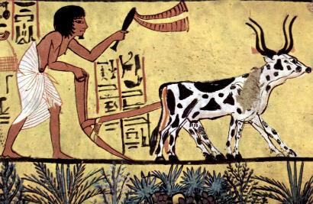
10,000 years ago, modern humans explored different ways of finding food and created the pathway for early farming.
The agricultural revolution meant that we no longer needed to move around to find food, and so became more sedentary and established fixed communities, still living together in small communities (or tribes)

Slide 13
Tribal culture is in our evolutionary history and many tribal communities exist across the world.
Some still live as hunter gatherers, living in balance and harmony with the natural world.
Many have modernised in ways but retain roots in elements of core tribal customs and traditions.
However, those of us who have moved away from our human history of tribalism have started to return to our roots and form what are now being described as new tribes…

Slide 14
How do you identify yourself?
Two of the main needs for people that encourage us to become part of groups /new tribes / gangs in society are:
Belongingness
Identity
All of us need to feel that we belong to something bigger than ourselves, this is a natural human trait.
However, within this, we all need to carve out our identity to separate ourselves from the rest of society or the group.

Slide 15
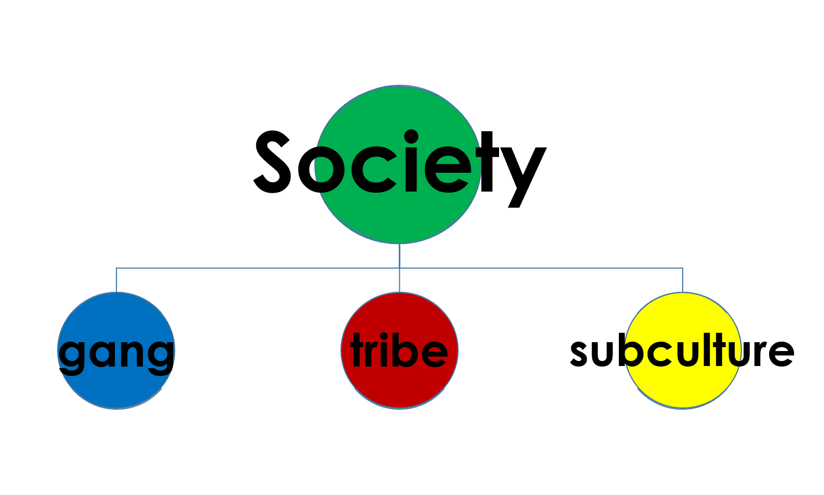
Part of our core human nature means that we have an inherent need to belong to something bigger than ourselves. You probably belong to at least two of these groups in society, whether you realise it or not…

Slide 16
Think about yourself, your culture, your community, the activities that you engage in outside of school; interest groups, hobbies or people who you spend time with.
Are you part of a gang?
Are you part of a subculture?
Are you part of a tribe?
Are you a part of all of these?
How would you define the groups that you are in?
Ask students to raise their hands for each category and make a tally of how many communities or groups the class belong to.

Slide 17
Now ask students to discuss the following question, thinking about all of the ideas raised in this module and any thoughts and personal experiences they may have:
Either run as a class discussion or ask students to write a reflection on this idea or create a poster or mind map.
“Is being part of a gang, tribe or sub-culture a “human need”?”

Slide 18
G A N G S
T H I S S O R T O F L E A R N I N G
C A N ’ T W A I T

