Slide 1
C L O T H E S
ENVIRONMENTAL ENGAGEMENT
Y7&8
11-13 years

Slide 2
F A S H I O N C U L T U R E
W E E K 1
3 0 M I N U T E S

Slide 3
In this lesson, students will:
THINK!
Think about and discuss how our culture and identity are explored through our clothing
Understand and explore how our emotional identities can be revealed within our clothing choices
Explore and unravel some of the stereotypes that prevail within our notion of clothing and some of the impacts of cultural appropriation
FEEL!
CONNECT!

Slide 4
P R E L E S S O N
R E F L E C T I O N S
3 – 5 M I N U T E S +

Slide 5
Introduce the following REFLECTIVE QUESTIONS for students to consider during the lesson:
How much do you care about the clothes that you wear?
What do you think your clothes say about you?
How can clothes give us clues about people and the cultures that they come from?

Slide 6
D O O U R C L O T H E S
H E L P U S T O T H I N K ?
1 0 M I N U T E S +

Slide 7
We all have clothes that we love to wear – and clothes that we love to wear at particular times or for particular occasions. For example, what you wear when you are lounging around the house may not be the same as what you choose to wear when you go for a night out.
So what is influencing what we are wearing?
Fashion trends?
Peer pressure?
Comfort?
Culture?
The weather?
Enclothed Cognition?

Slide 8
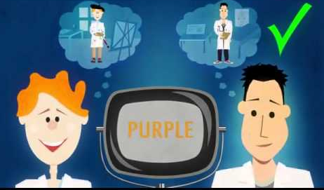
Watch the short video (1.49 mins) made by David McRaney entitled:
Enclothed Cognition
(click on the hyperlink above)
Allow students a few minutes to respond to the film with people sitting near to them and then discuss together the following questions:

Slide 9
Have you ever experienced the idea of ‘enclothed cognition’ (e.g. have you felt different or thought in a different way because of what you are wearing?

Slide 10
Split the class into small groups and give each group one of these clothing influences.
Ask them to think about and talk about how this influence would encourage us to wear clothes at particular occasions, and whether this is a significant influence on their own choices. Discuss together and then share ideas together as a class.
Fashion trends | Peer pressure | Comfort
Culture | The weather | “Enclothed cognition”

Slide 11
Does what we wear influence how we think and feel?
Think about your own responses to this question and then share thoughts together as a class.

Slide 12
C L O T H I N G A N D C U L T U R E
2 0 M I N U T E S +

Slide 13
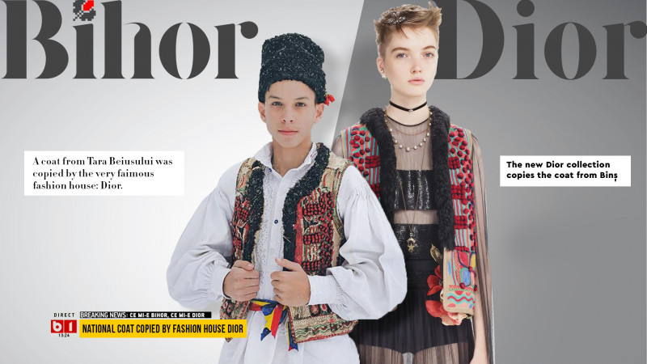
Watch the short video (2.34 mins) made by Romanian fashion organisation Bihour Couture entitled:
Bihour Couture. The Story
(click on the hyperlink above)
Allow students a few minutes to respond to the film with people sitting near to them and then discuss together the following questions:

Slide 14
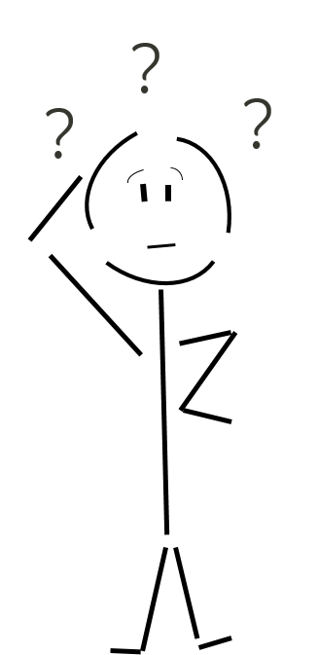
Have you ever heard of the term ‘cultural appropriation’ before? What might this mean?
See the next slide for some definitions…

Slide 15
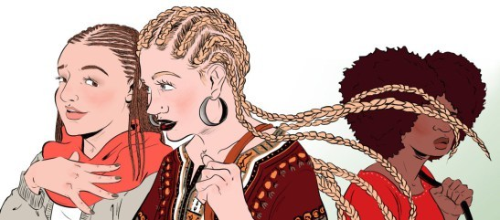
The Oxford English Dictionary defines cultural appropriation as:
“The unacknowledged or inappropriate adoption of the customs, practices, ideas, etc. of one people or society by members of another and typically more dominant people or society.”
In other words it is when someone adopts something from a culture that is not his or her own. It might be a hairstyle, a piece of clothing, a manner of speaking, even a type of exercise (yoga, for example).

Slide 16
Is cultural appropriation OK? Why? Why not? What are some of the issues and problems?
Do you think it is OK for fashion designers to ‘borrow’ ideas from different cultures and traditions around the world? Why? Why not?

Slide 17
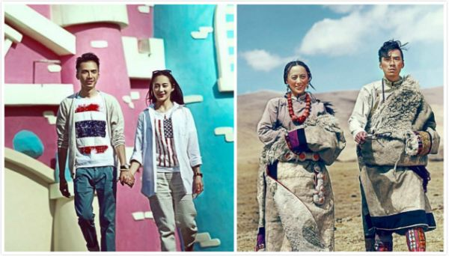
Now watch this short video (3.44 mins) put together by ThoughtBox entitled:
Culture and Stereotypes
click on the link above
Allow students a few minutes to respond to the film with people sitting near to them and then discuss some of the questions that came up in the film.
:

Slide 18
Take a look at the still images from the collection. The pictures were taken to celebrate the wedding of Gerong Phuntsok and Dawa Drolma, who wanted to capture all elements of their lives – the traditional Tibetan cultures which they follow and the urban life that they also lead.
Look at each picture and discuss some of the stereotypes, assumptions and messages that the couples may be giving because of what they are wearing.

Slide 19
What do the clothes they are wearing make you assume about who they are?

Slide 20
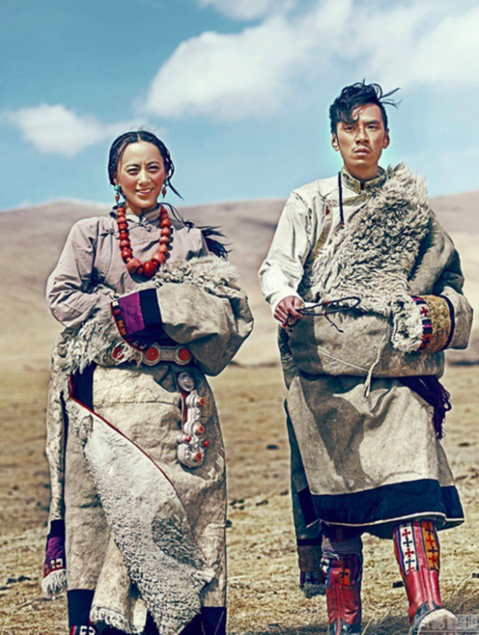
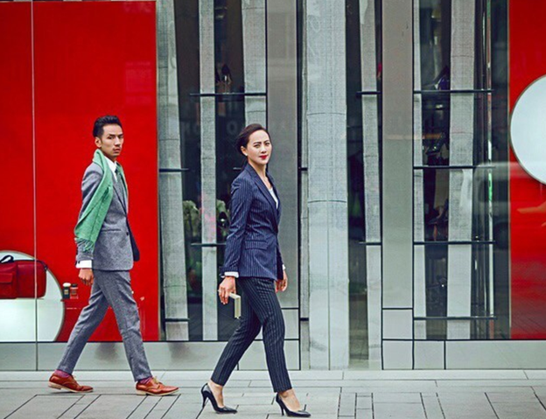
What do the clothes they are wearing make you assume about who they are?

Slide 21
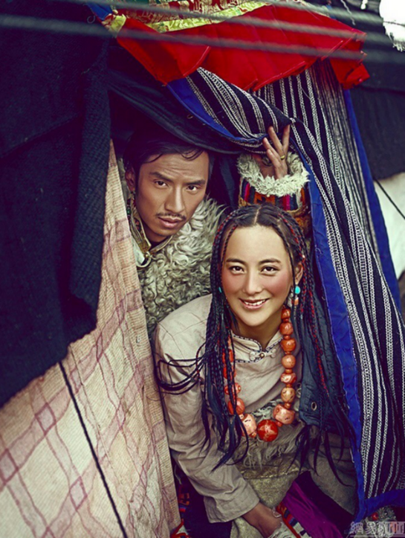
What do the clothes they are wearing make you assume about who they are?

Slide 22
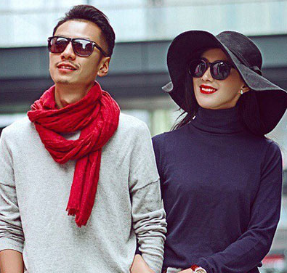
What do the clothes they are wearing make you assume about who they are?

Slide 23
What do the clothes they are wearing make you assume about who they are?

Slide 24
Is it useful to look for clues about someone through their clothing? Why?

Slide 25
C L O T H E S
T H I S S O R T O F L E A R N I N G
C A N ’ T W A I T

